Slide 1
Missing Migrants Machine Learning Project (2014-22)
Raman Kadariya

Slide 2
Objectives
To understand the Circumstances behind deaths & Missing migrants’ cases
To analyze & predict future incidents to Understand overall patterns in the data
to avoid a recurrence of these Tragic Events and save migrants lives

Slide 3
Data Description
The dataset comes from the Missing Migrant Project, from United Nations International Organization for Migration (IOM) website that tracks the deaths of migrants who have died or gone missing on their journey to their destination.

Slide 4
Missing Migrant Dataset Variables
Variable Name | Description
Web ID | An automatically generated number used to identify each unique entry in the dataset.
Region of incident | The region in which an incident took place.
Reported date | Estimated date of death.
Reported year | The year in which the incident occurred.
Reported month | The month in which the incident occurred.
Number dead | The total number of people confirmed dead in one incident, i.e. the number of bodies recovered.
Number missing | The total number of those who are missing and are thus assumed to be dead.
Total dead and missing | The sum of the ‘number dead’ and ‘number missing’ variables.
Number of survivors | The number of migrants that survived the incident, if known.
Number of females | Indicates the number of females found dead or missing.
Number of males | Indicates the number of males found dead or missing.
Number of children | Indicates the number of individuals under the age of 18 found dead or missing.
Age | The age of the decedent(s). Occasionally, an estimated age range is recorded.
Country of origin | Country of birth of the decedent.
Region of origin | Region of origin of the decedent(s).
Cause of death | The determination of conditions resulting in the migrant's death i.e. the circumstances of the event that produced the fatal injury.
Location description | Place where the death(s) occurred or where the body or bodies were found. Nearby towns or cities or borders are included where possible.
Location coordinates | Place where the death(s) occurred or where the body or bodies were found.
Migration route | Name of the migrant route on which incident occurred, if known.
UNSD geographical grouping | Geographical region in which the incident took place, as designated by the United Nations Statistics Division (UNSD) geoscheme.
Information source | Name of source of information for each incident. Multiple sources may be listed.
Link | Links to original reports of migrant deaths / disappearances if available. Multiple links may be listed.
Source quality | Incidents are ranked on a scale from 1-5 based on the source(s) of information available.
Comments | Brief description narrating additional facts about the death.

Slide 5
Visualizing Data

Slide 6
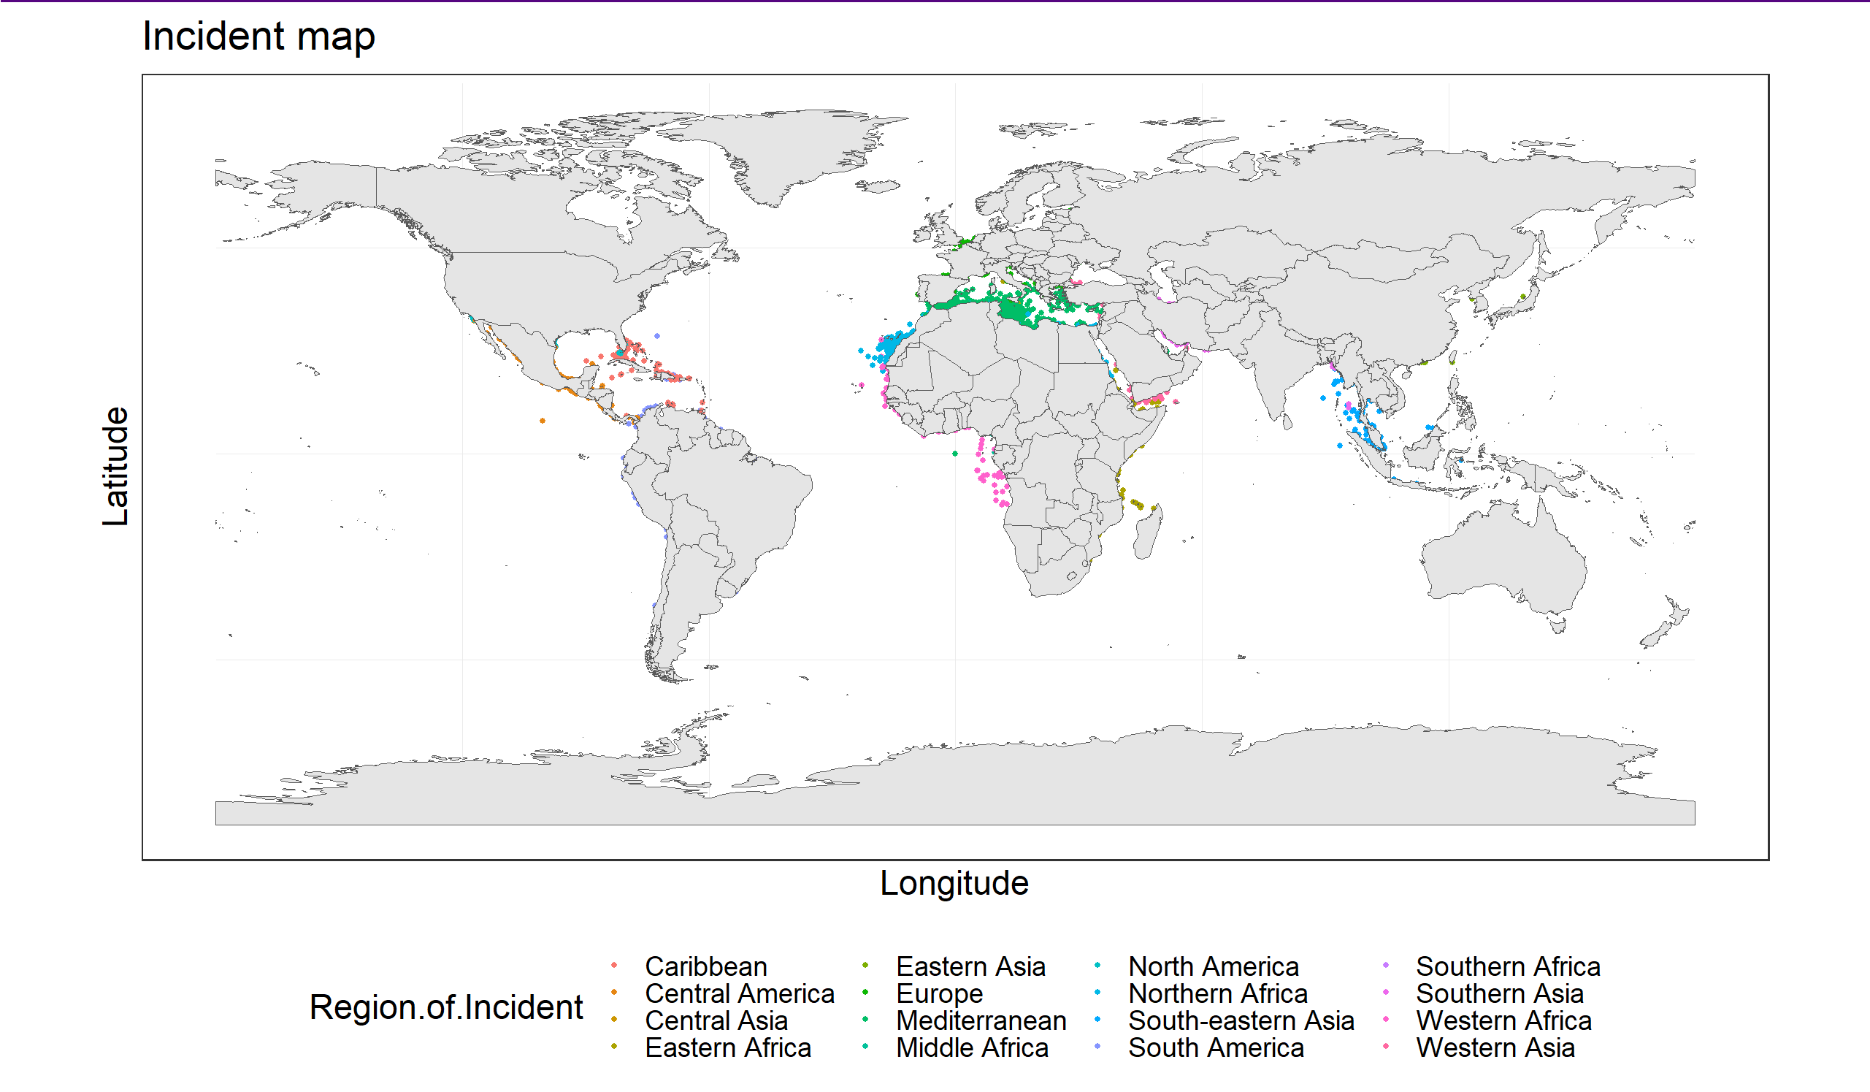

Slide 7
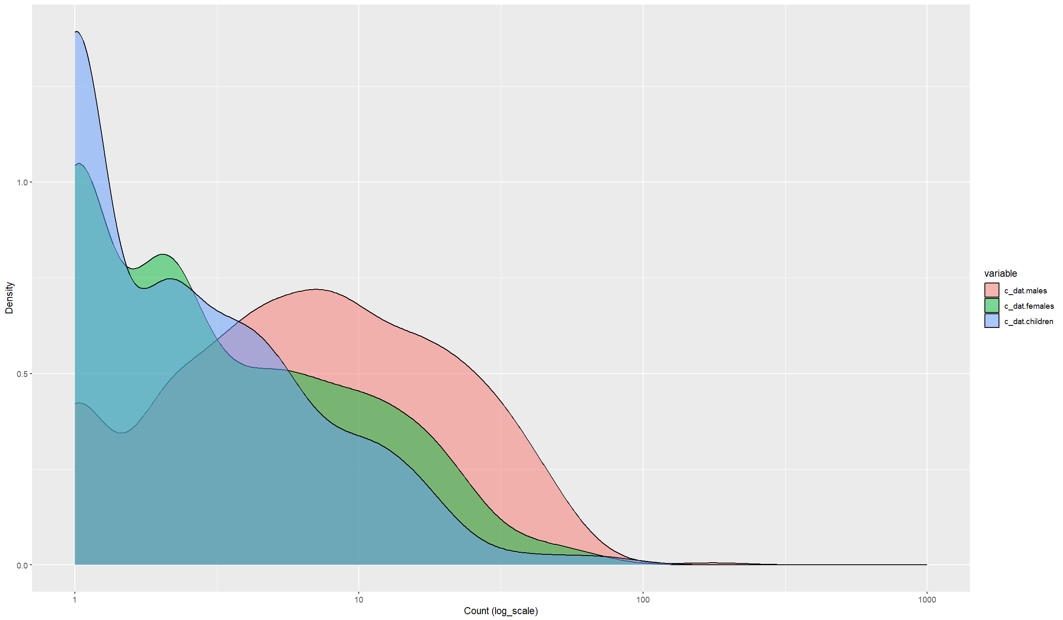

Slide 8
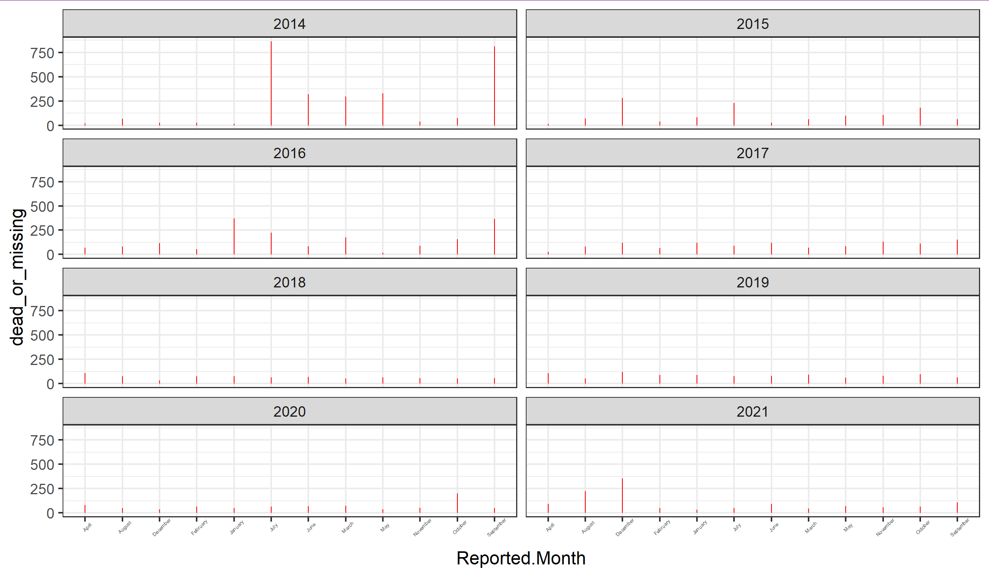

Slide 9
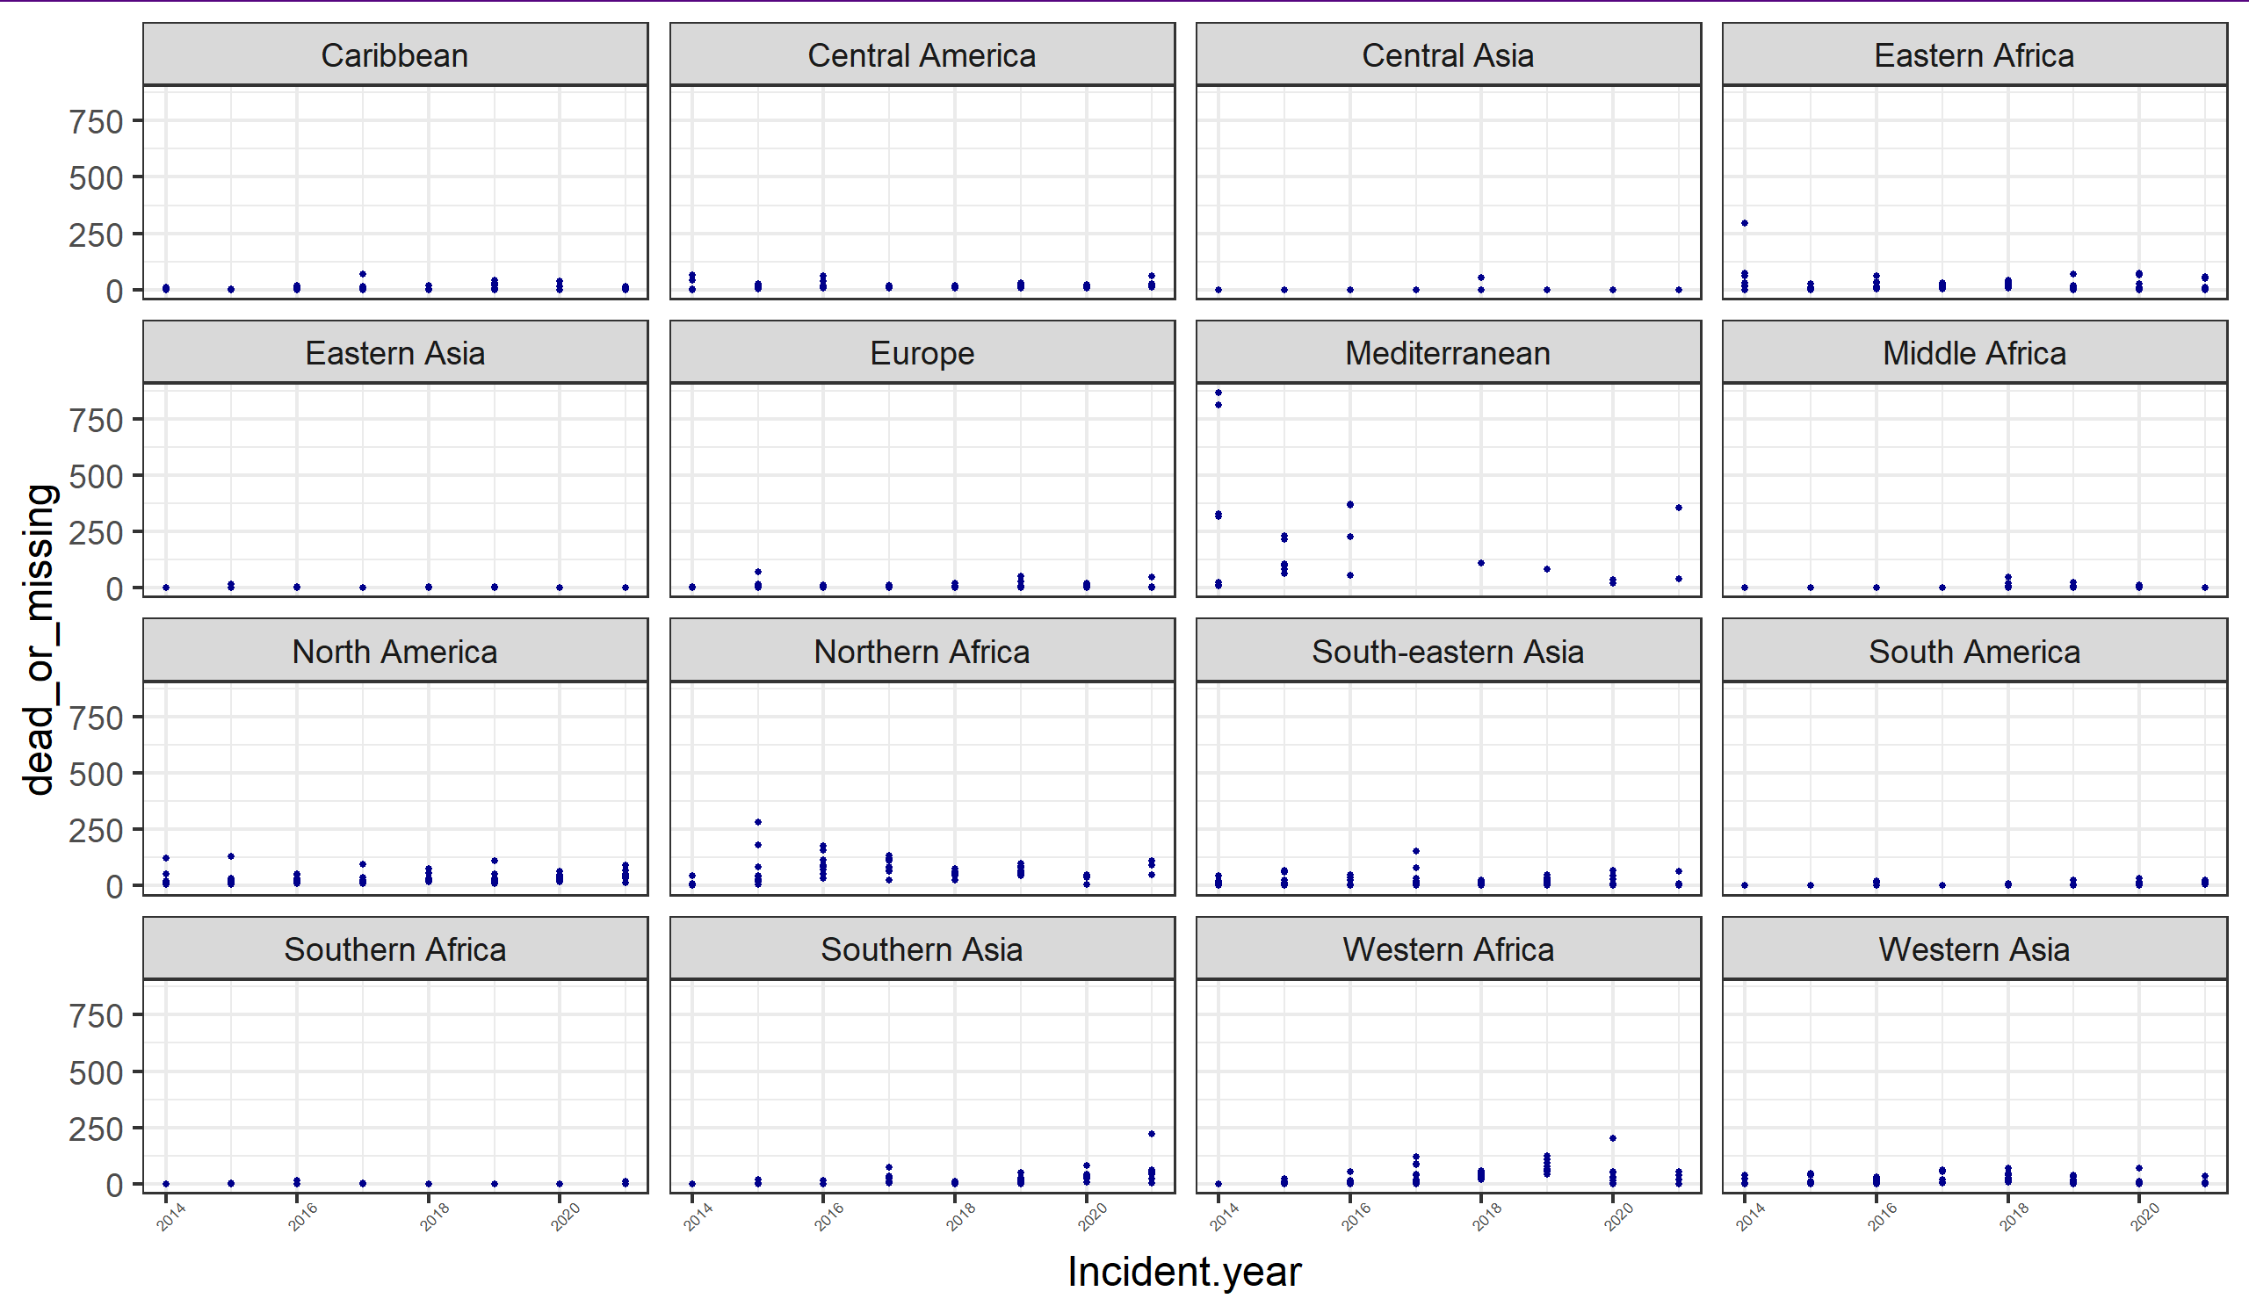

Slide 10
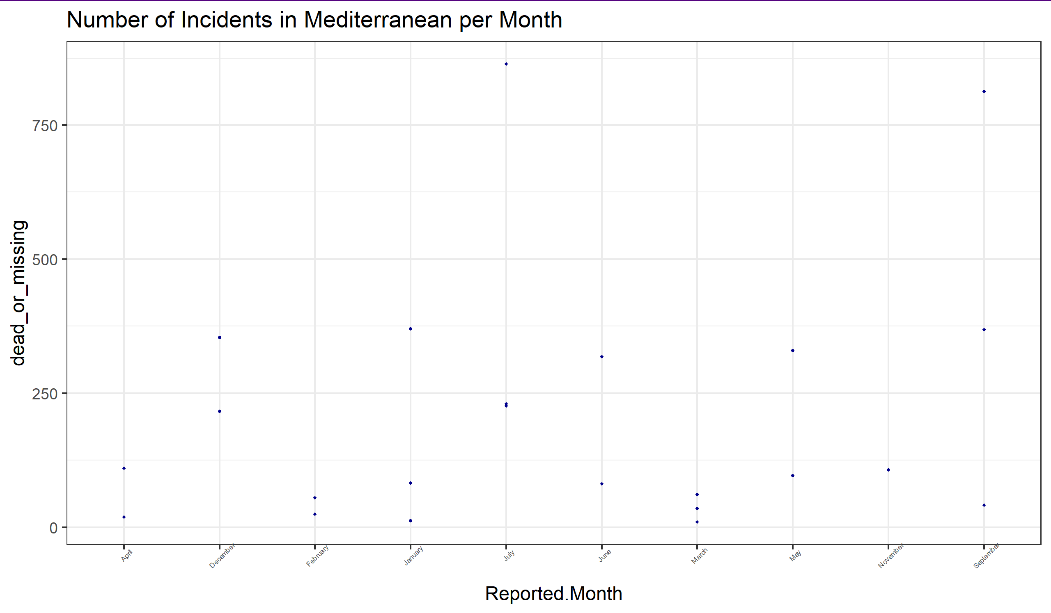
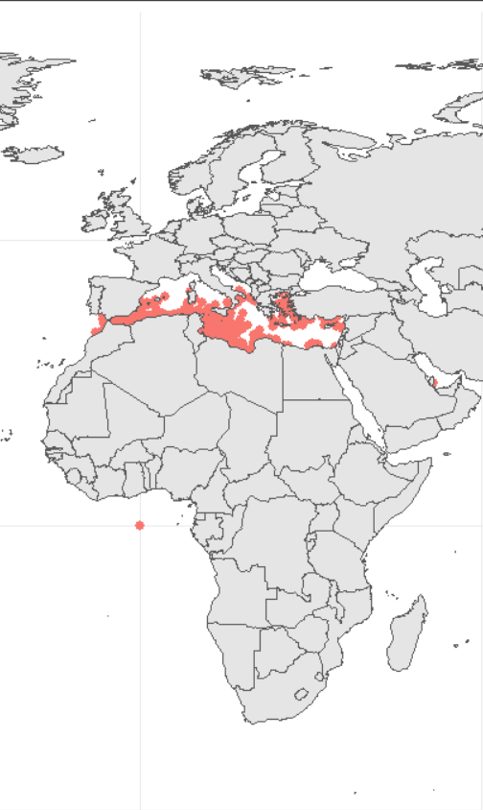
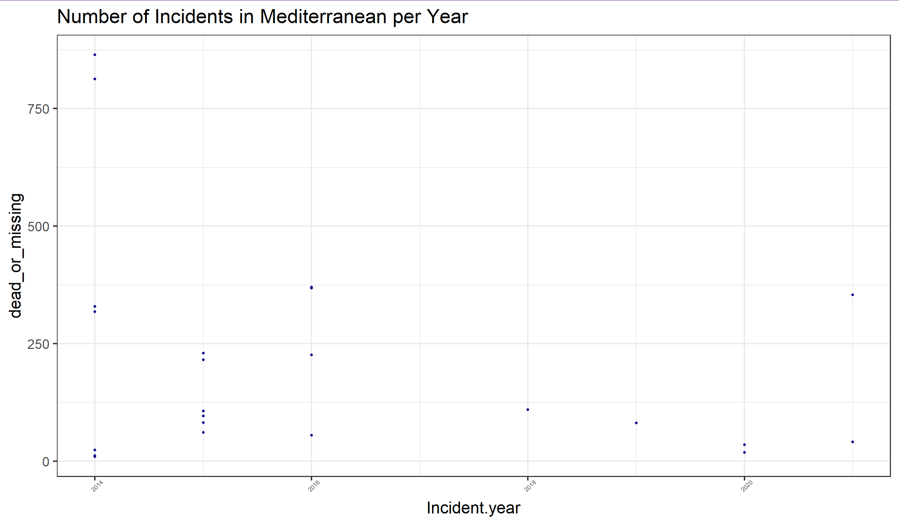
Mediterranean Region
The highest frequency of migrants’ death and missing cases occur in the central Mediterranean.
2014 has had the highest recorded cases.
July is the month with highest recorded cases.

Slide 11
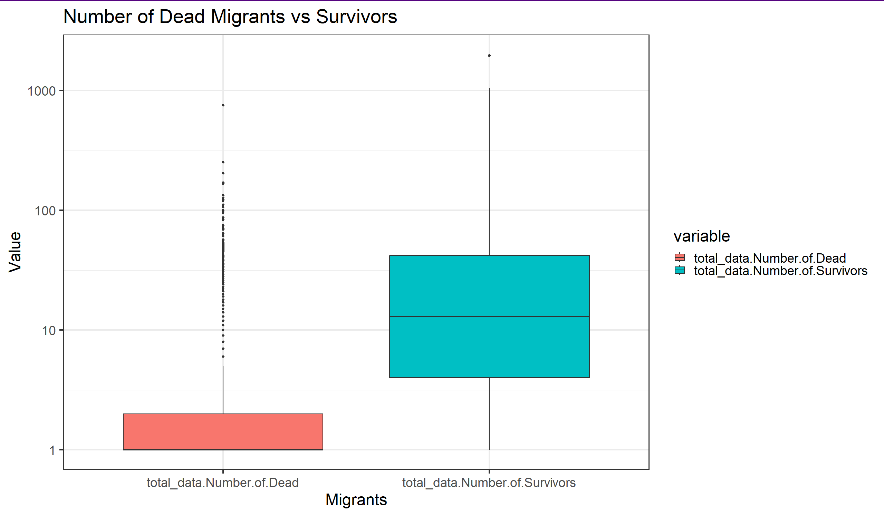

Slide 12
Statistical Analysis

Slide 13
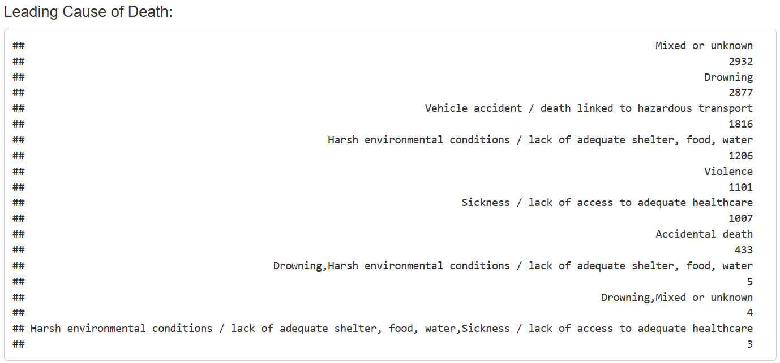
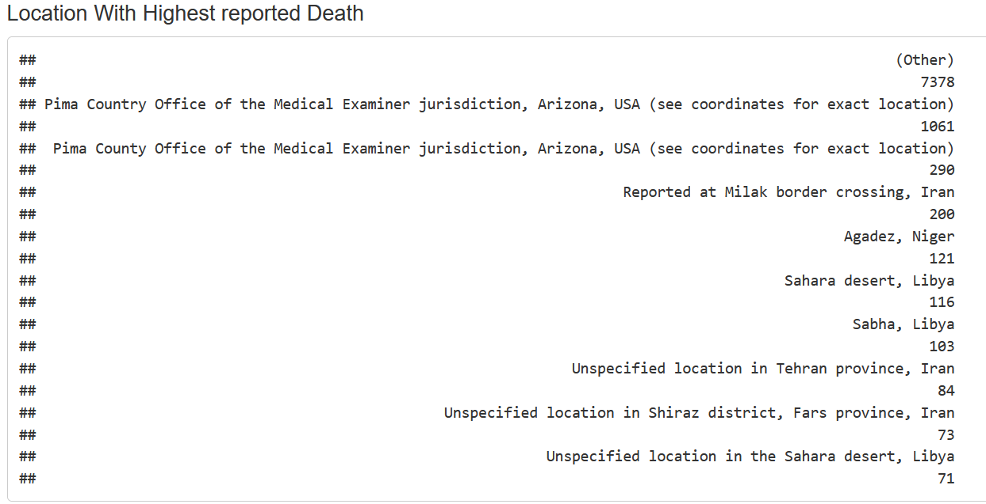
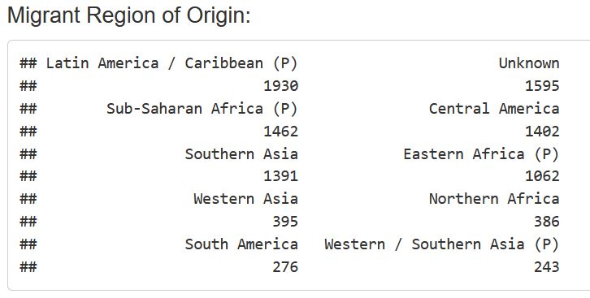
Beside unknow cases, drowning is the leading cause of migrants’ death.
Since 2014, Arizona, USA &, Milak, Iran has reported highest death cases.
Latin America/ Caribbean, & Sub-Saharan Africa has highest refugee origin over the years.

Slide 14
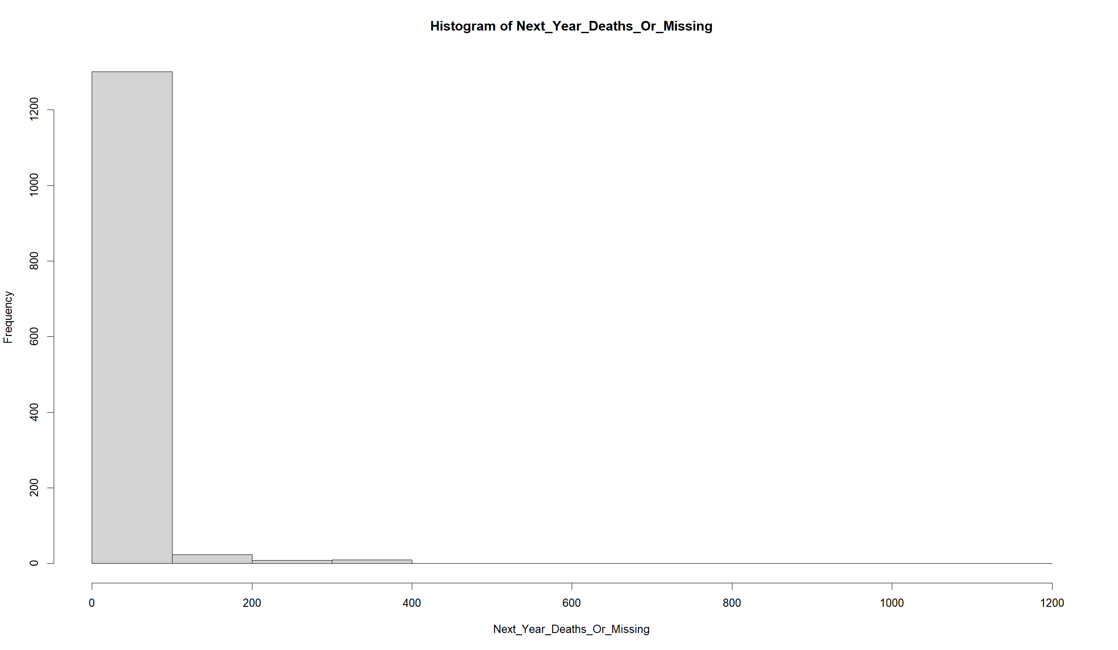
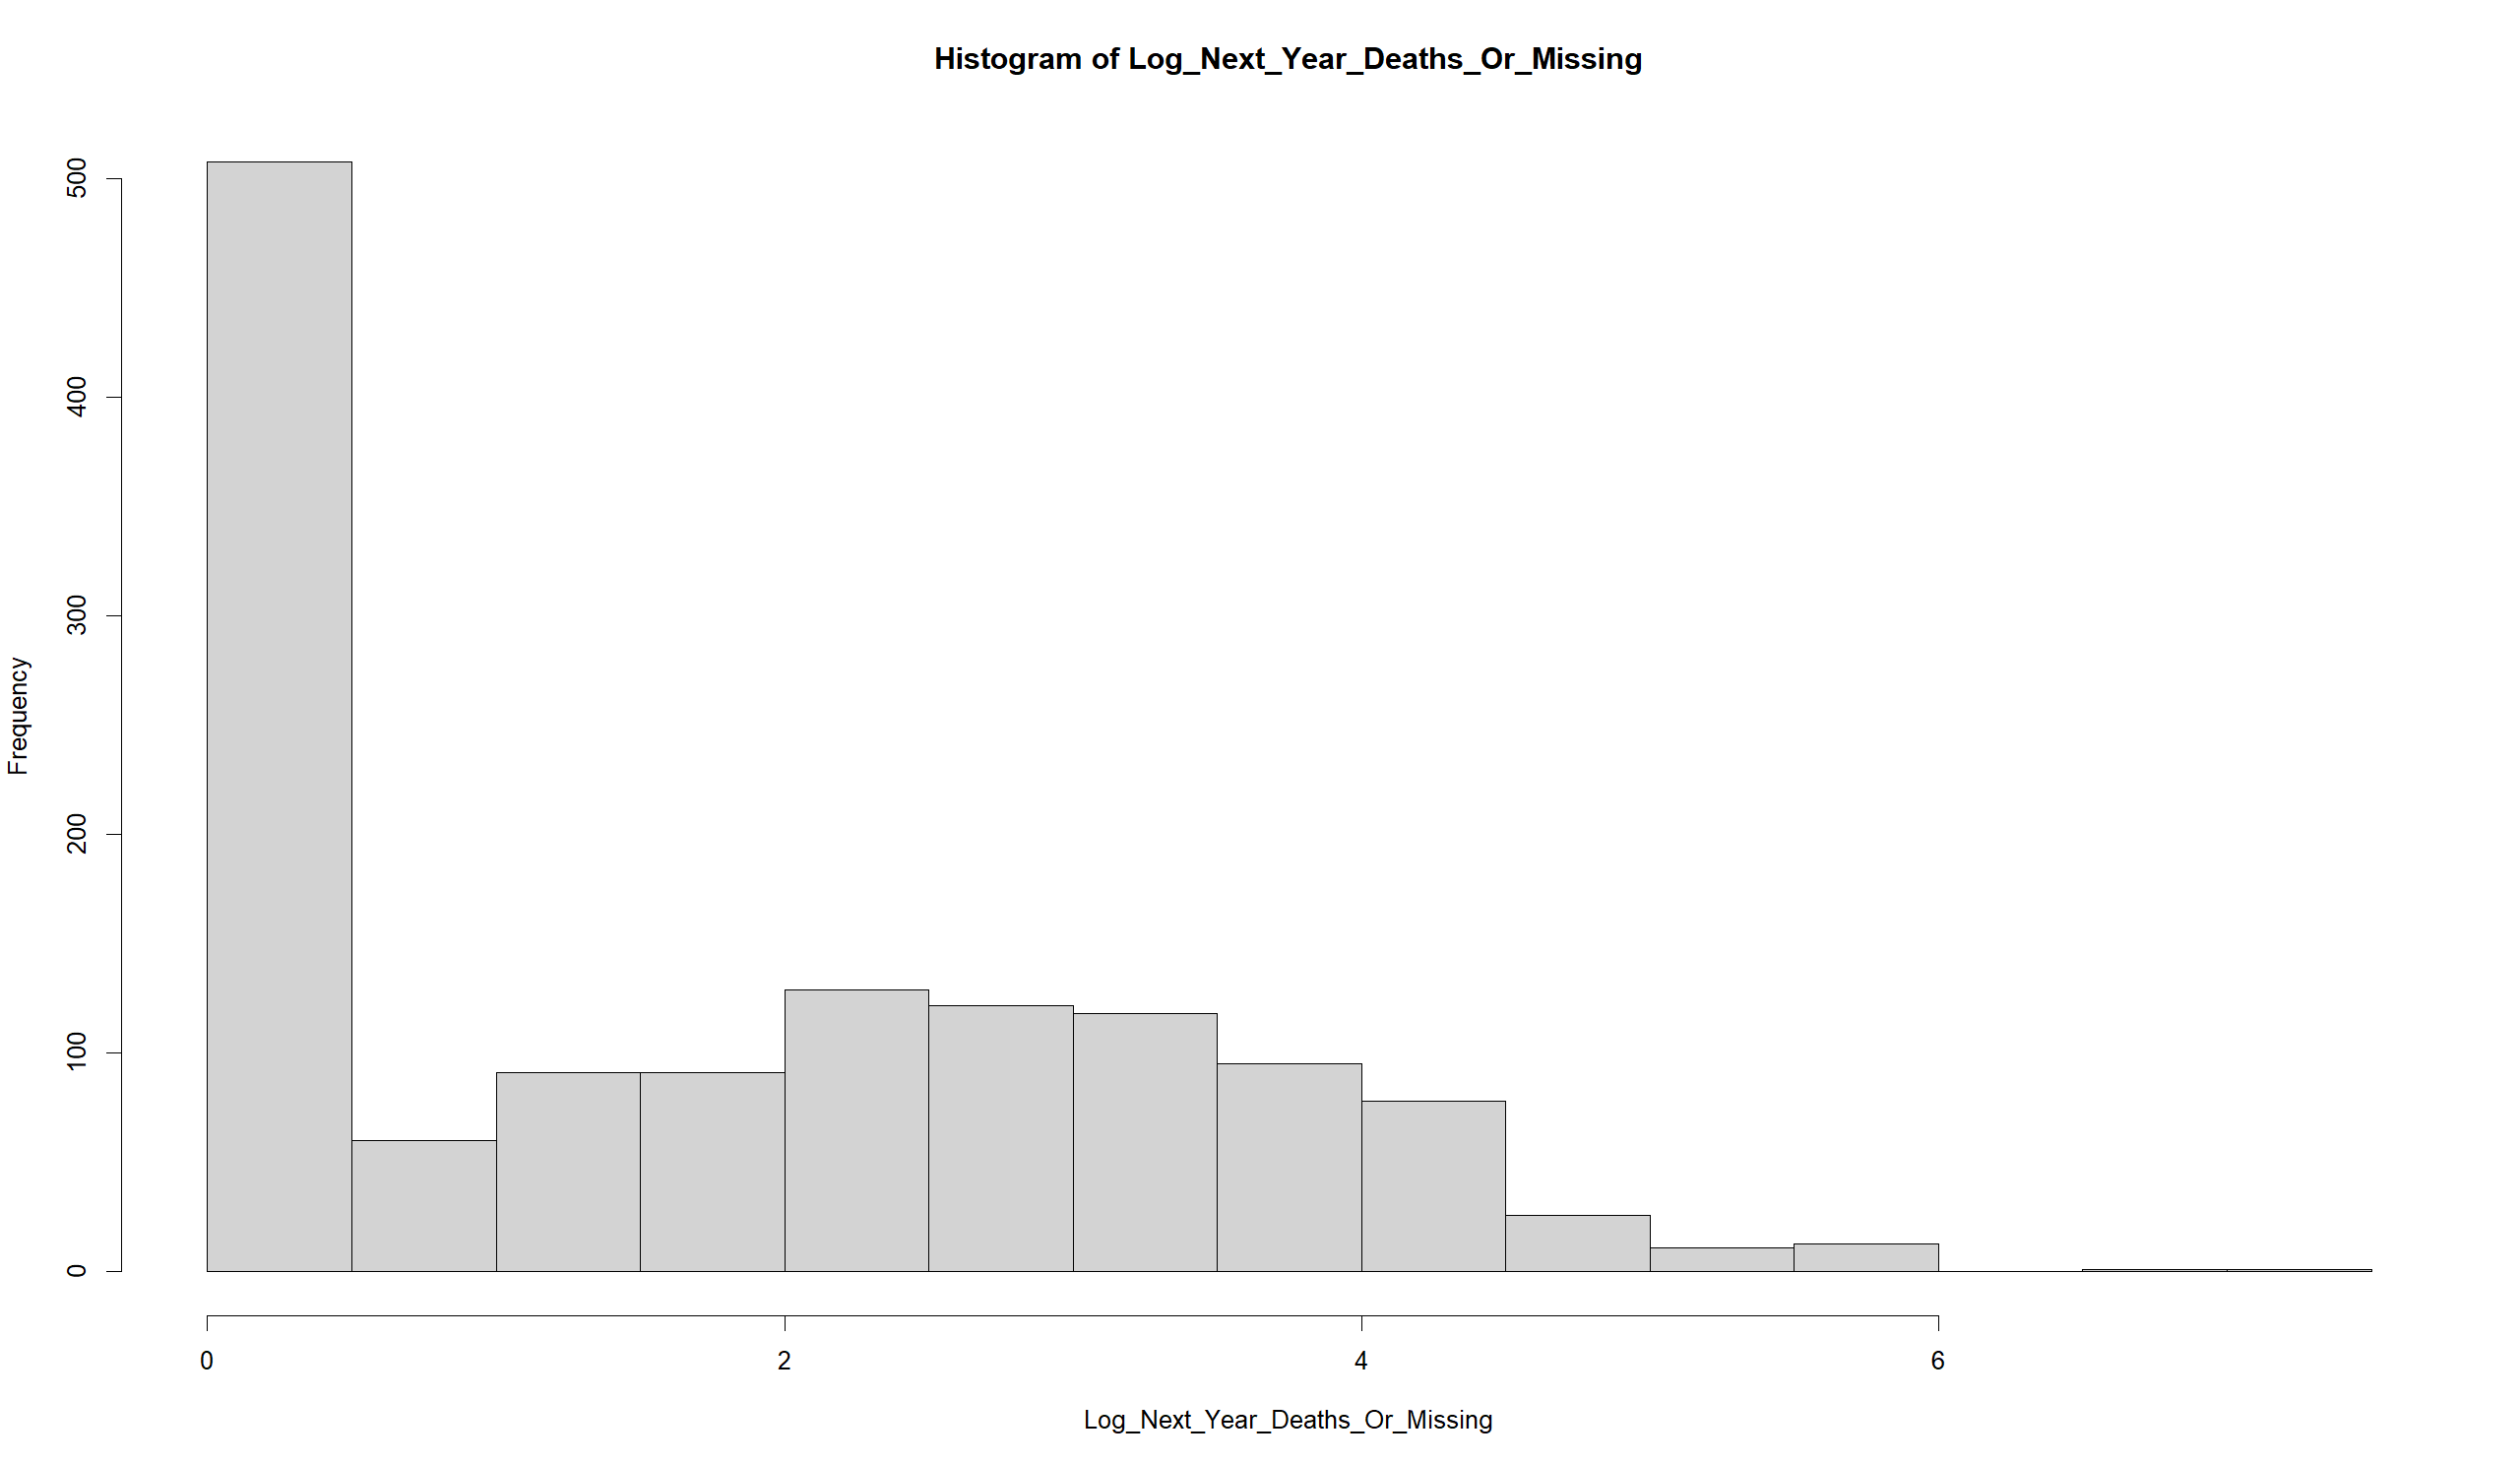
Linear Regression to Predict Future Migrants’ Deaths and Missing Cases

Slide 15
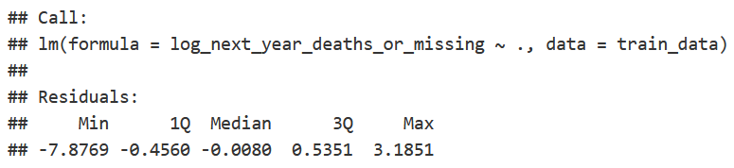
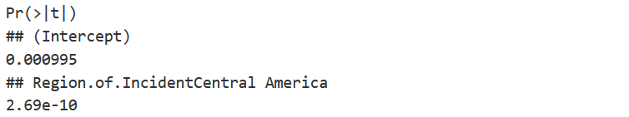
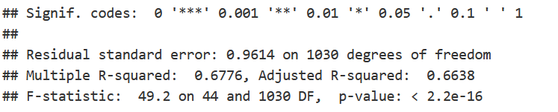
LM_FULL

Slide 16
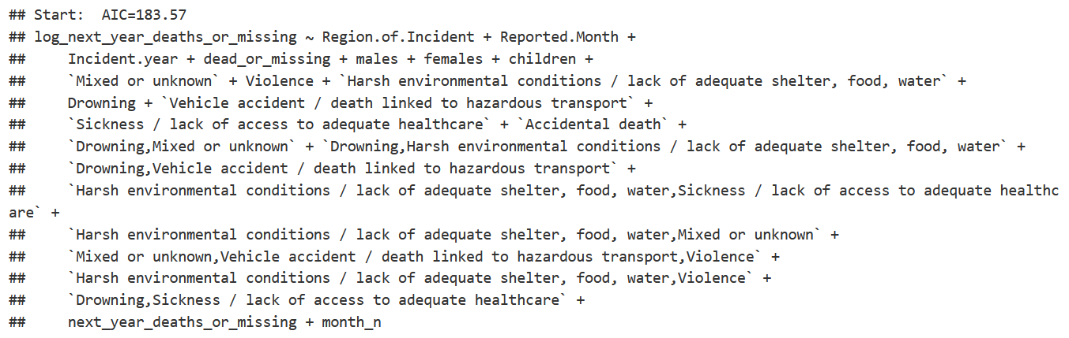
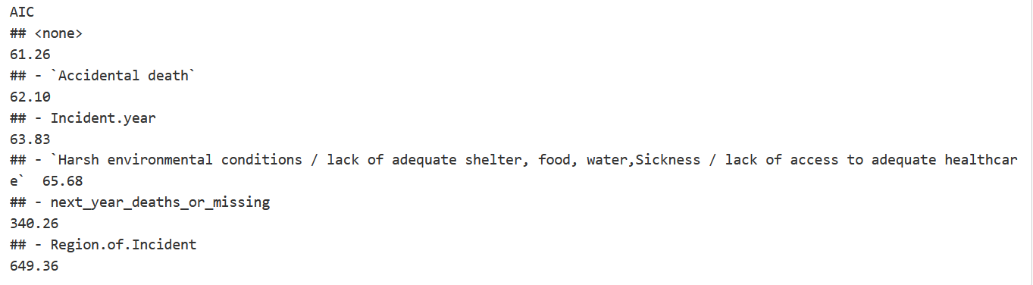
LM_BWD

Slide 17
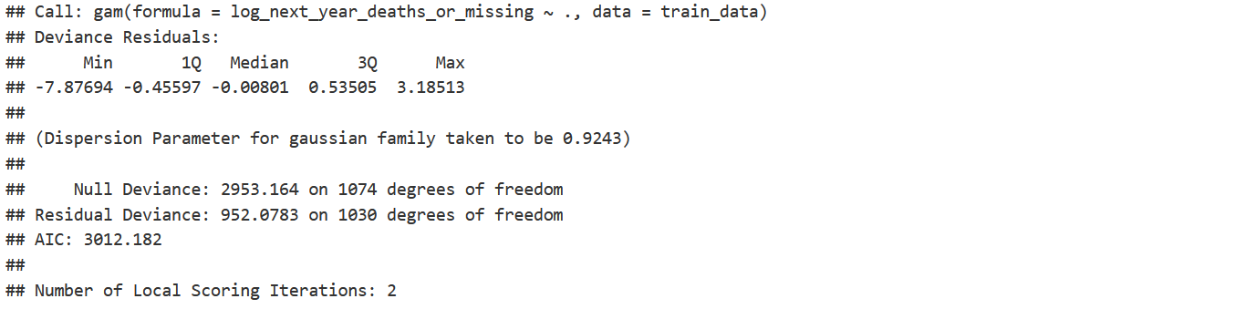
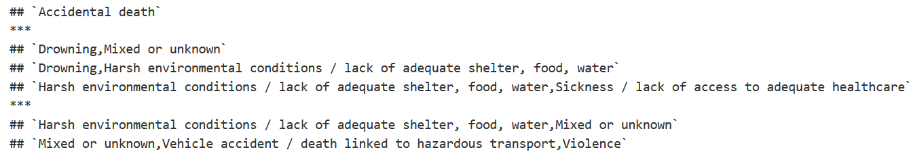
GAM

Slide 18
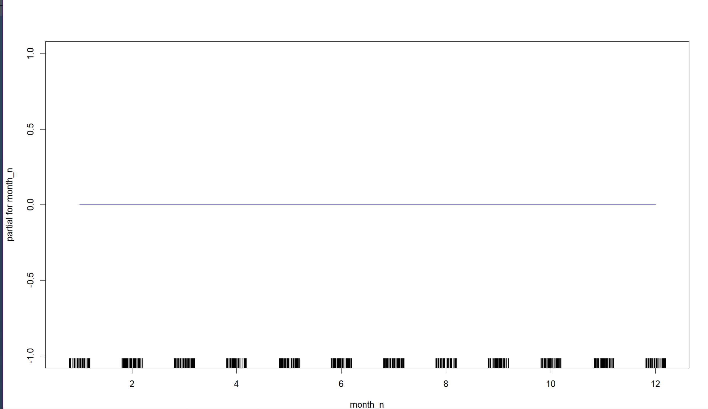
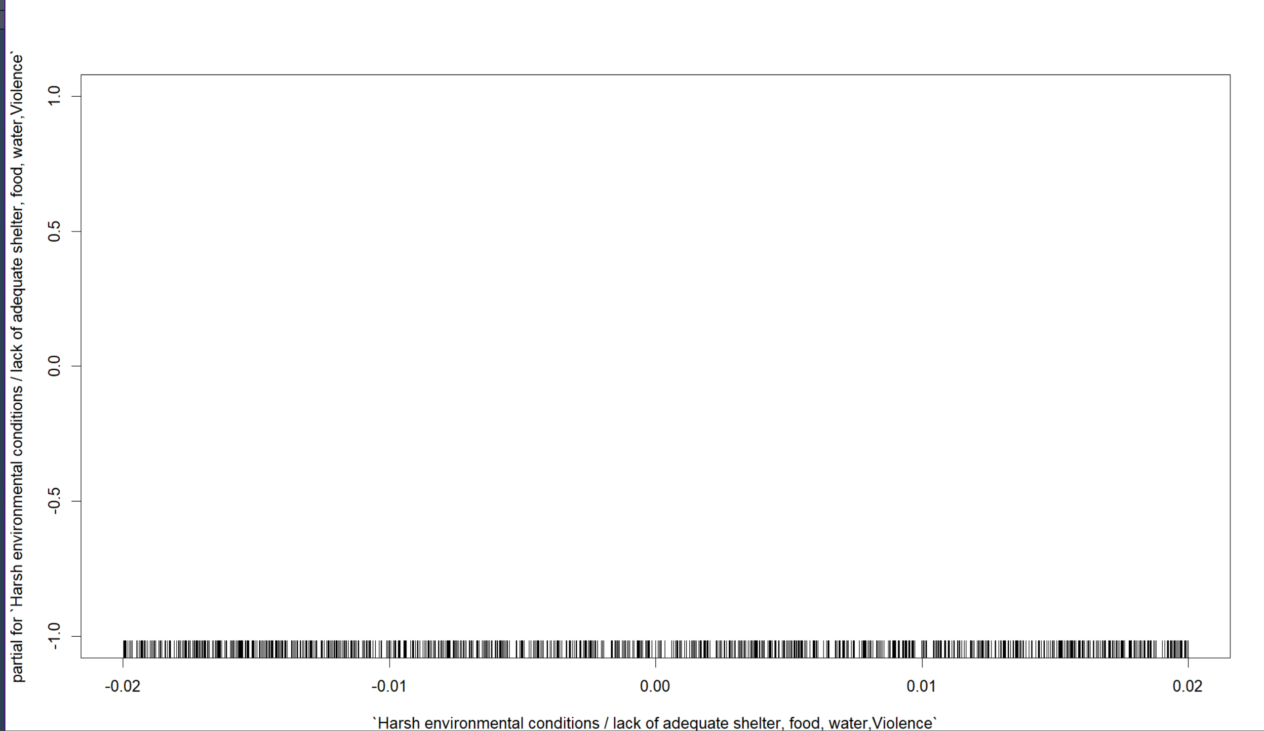
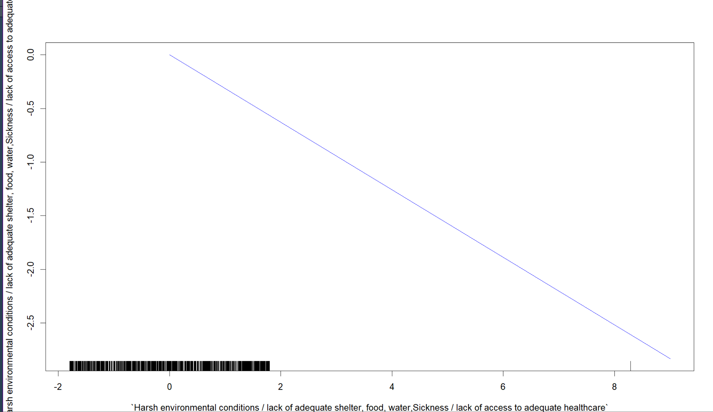
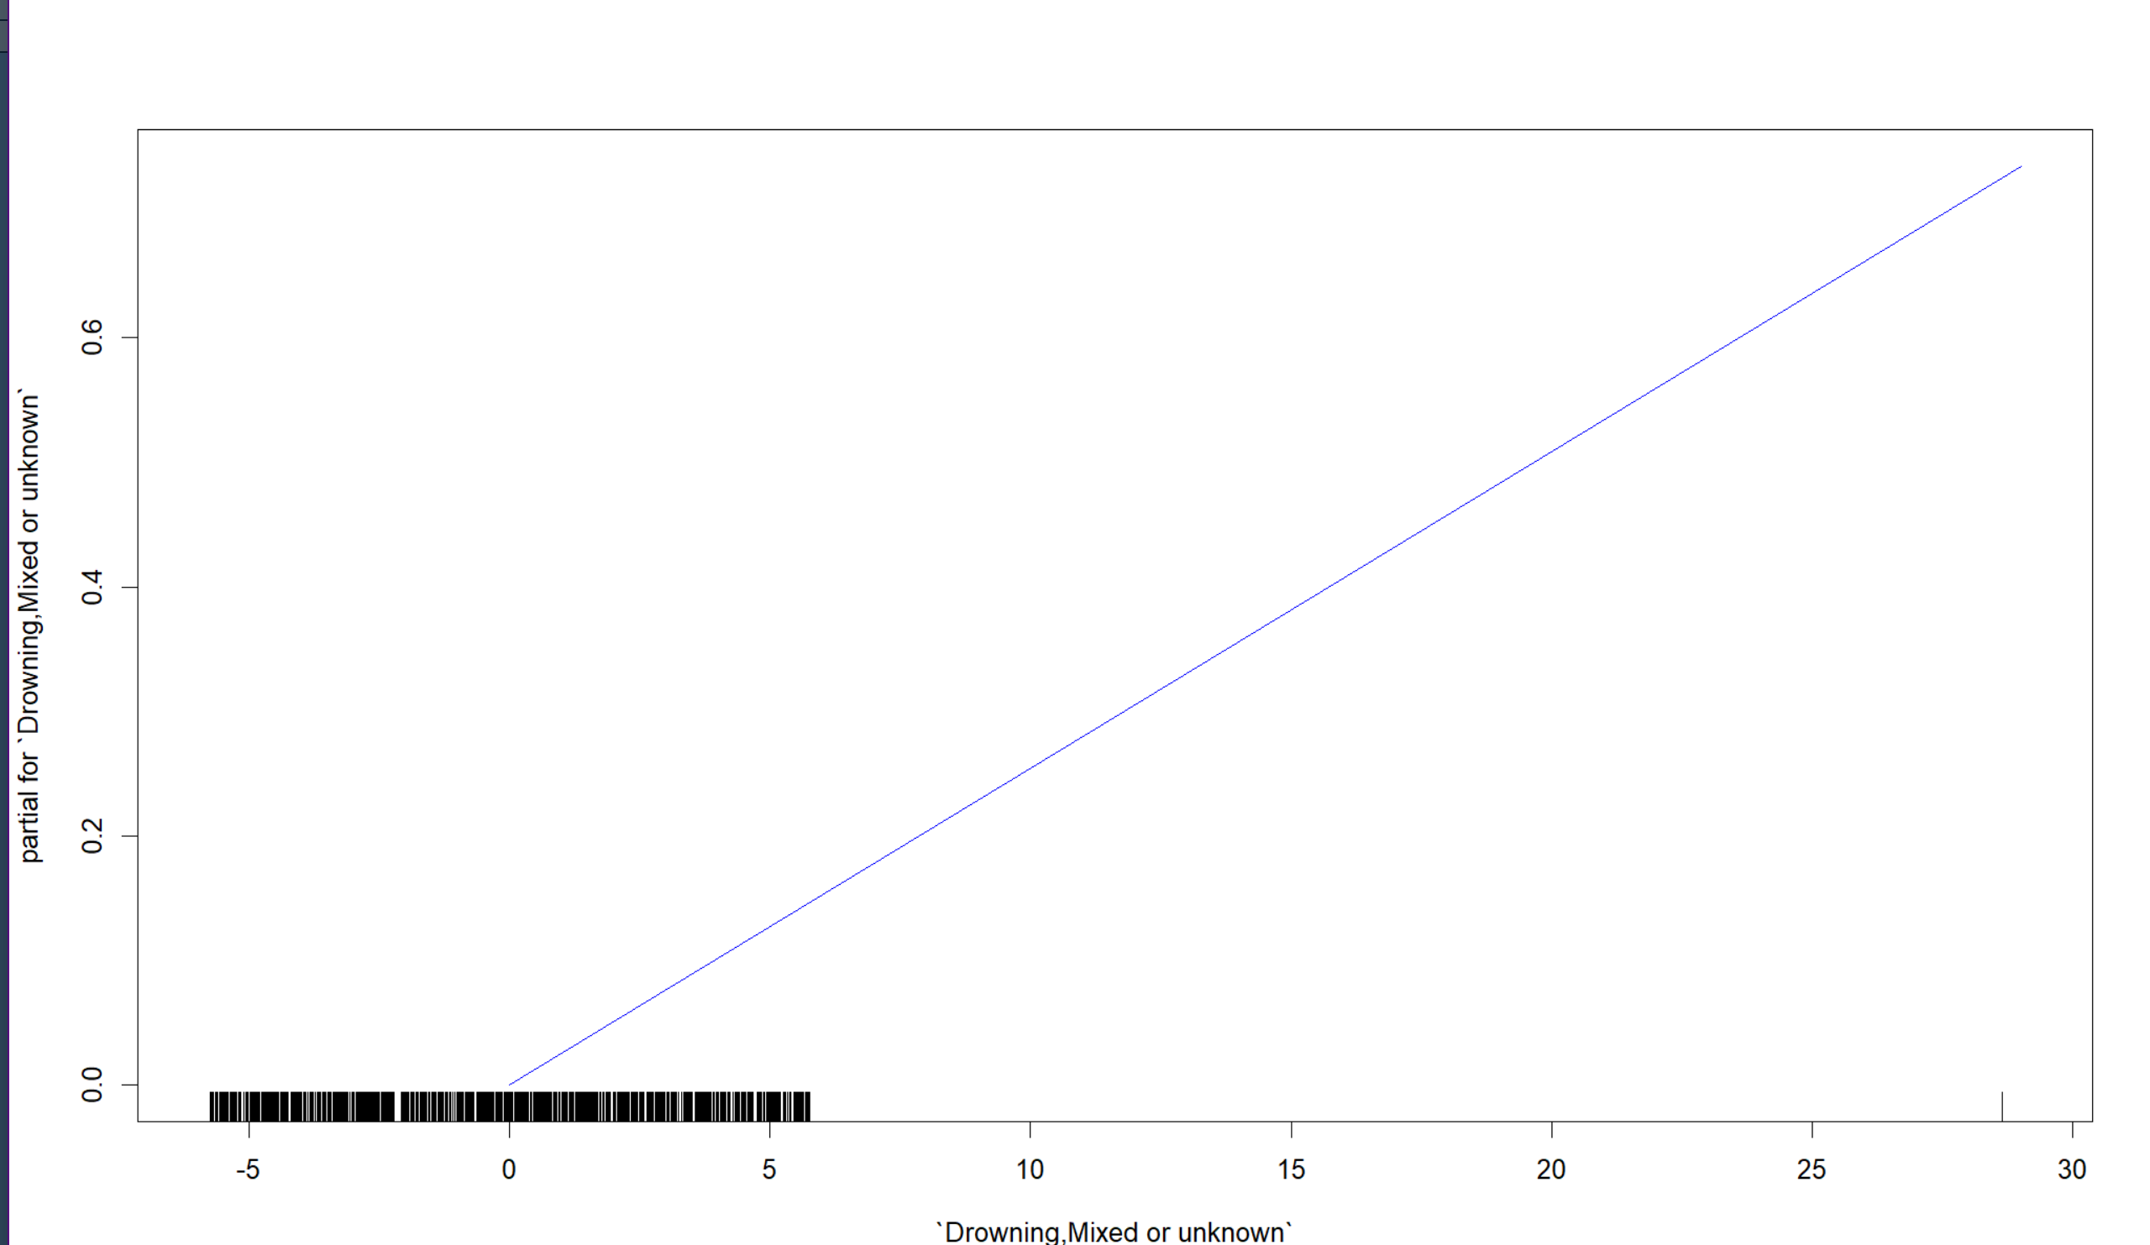
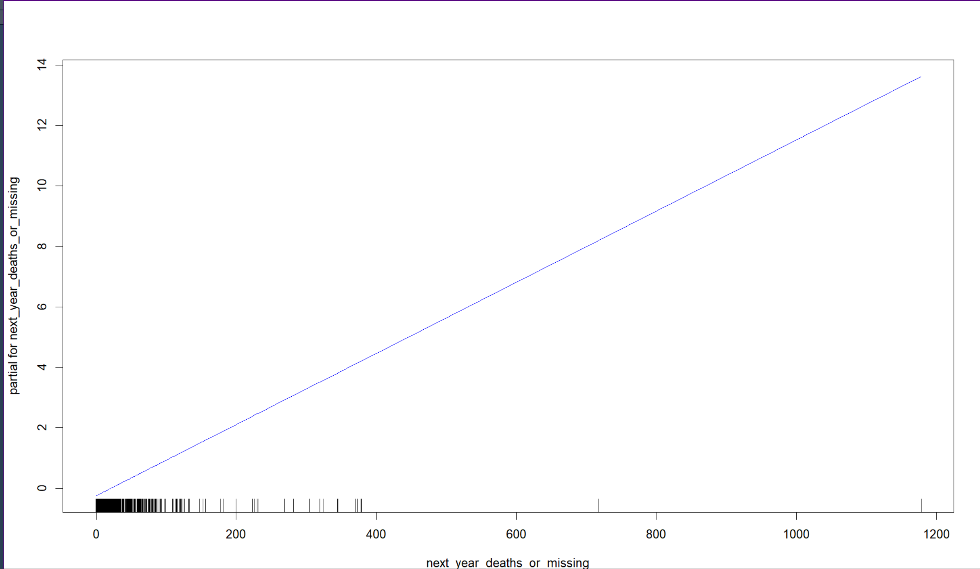
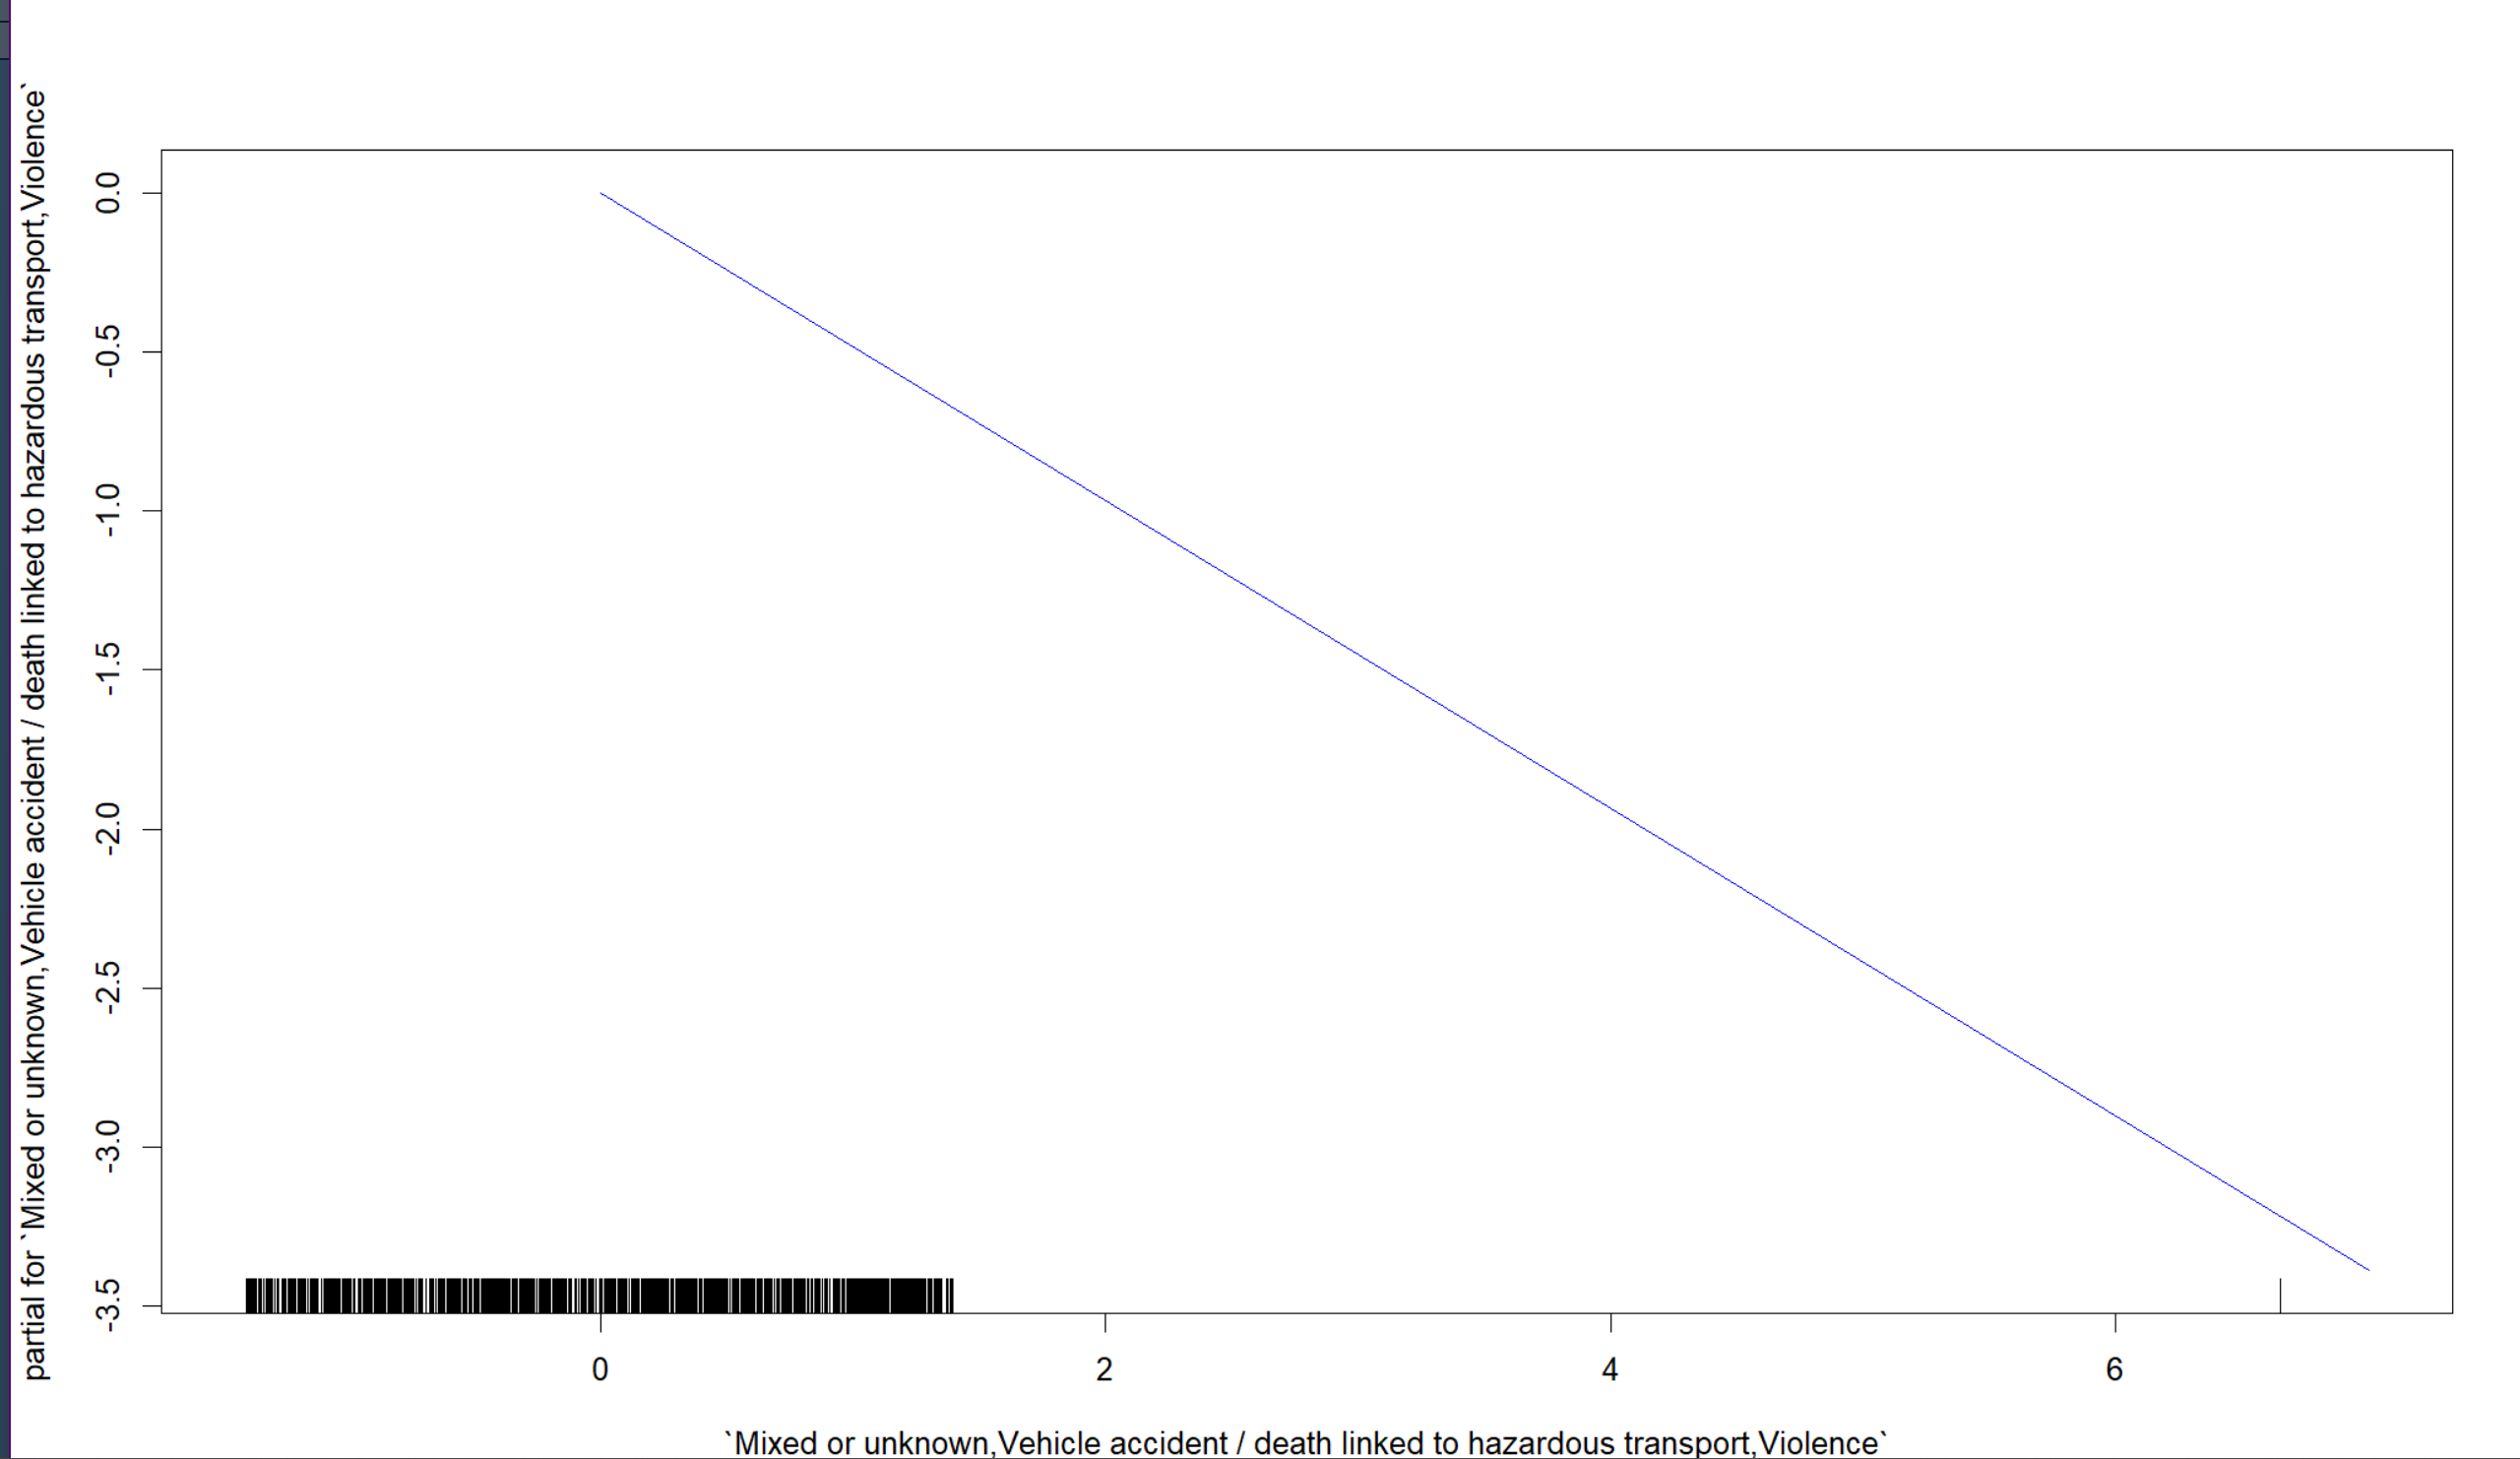
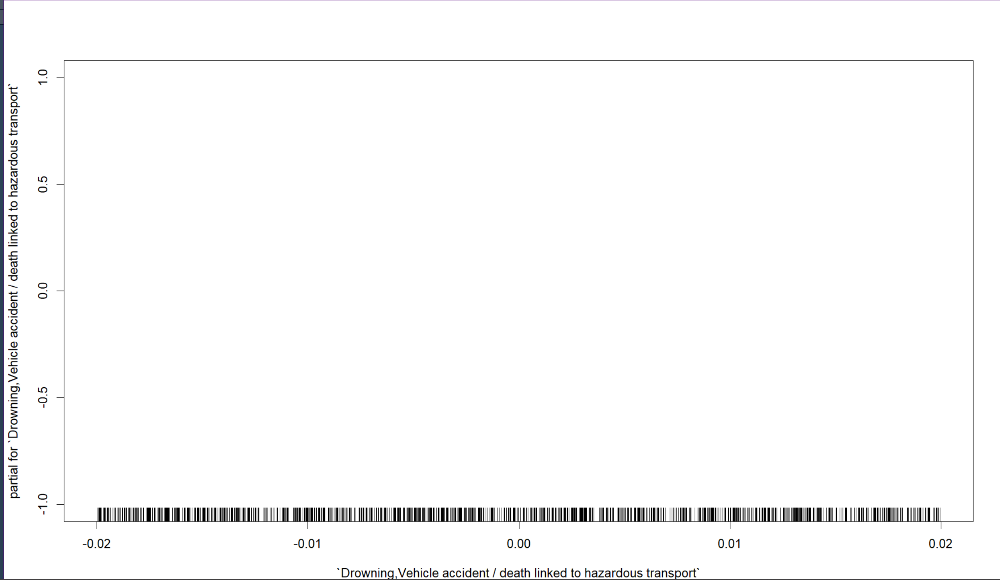
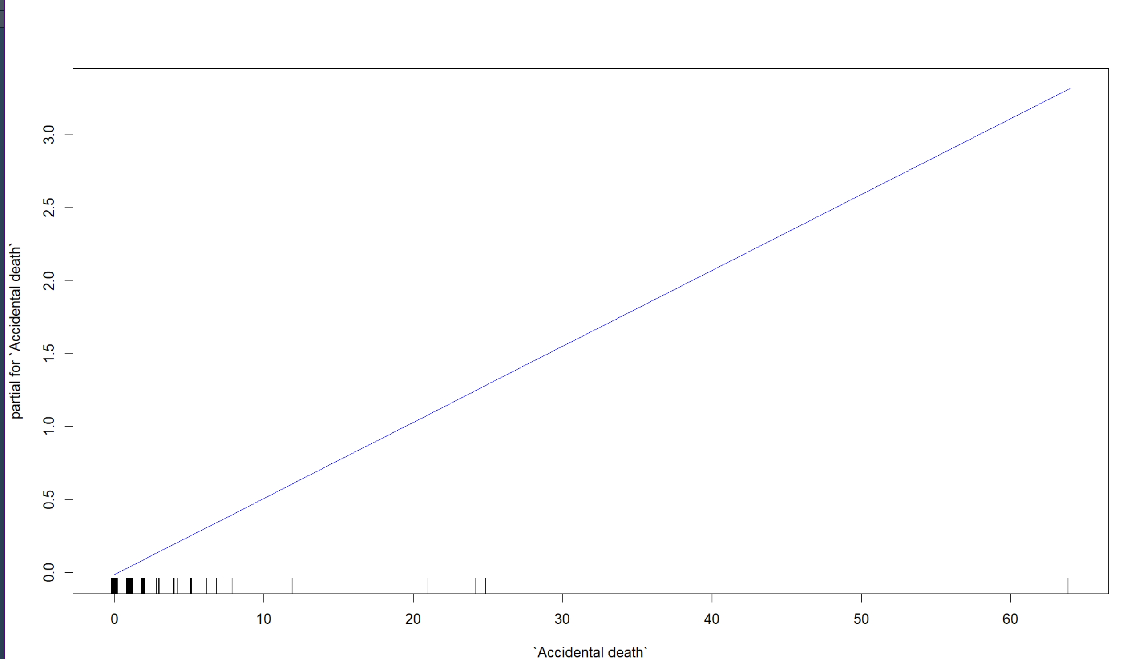
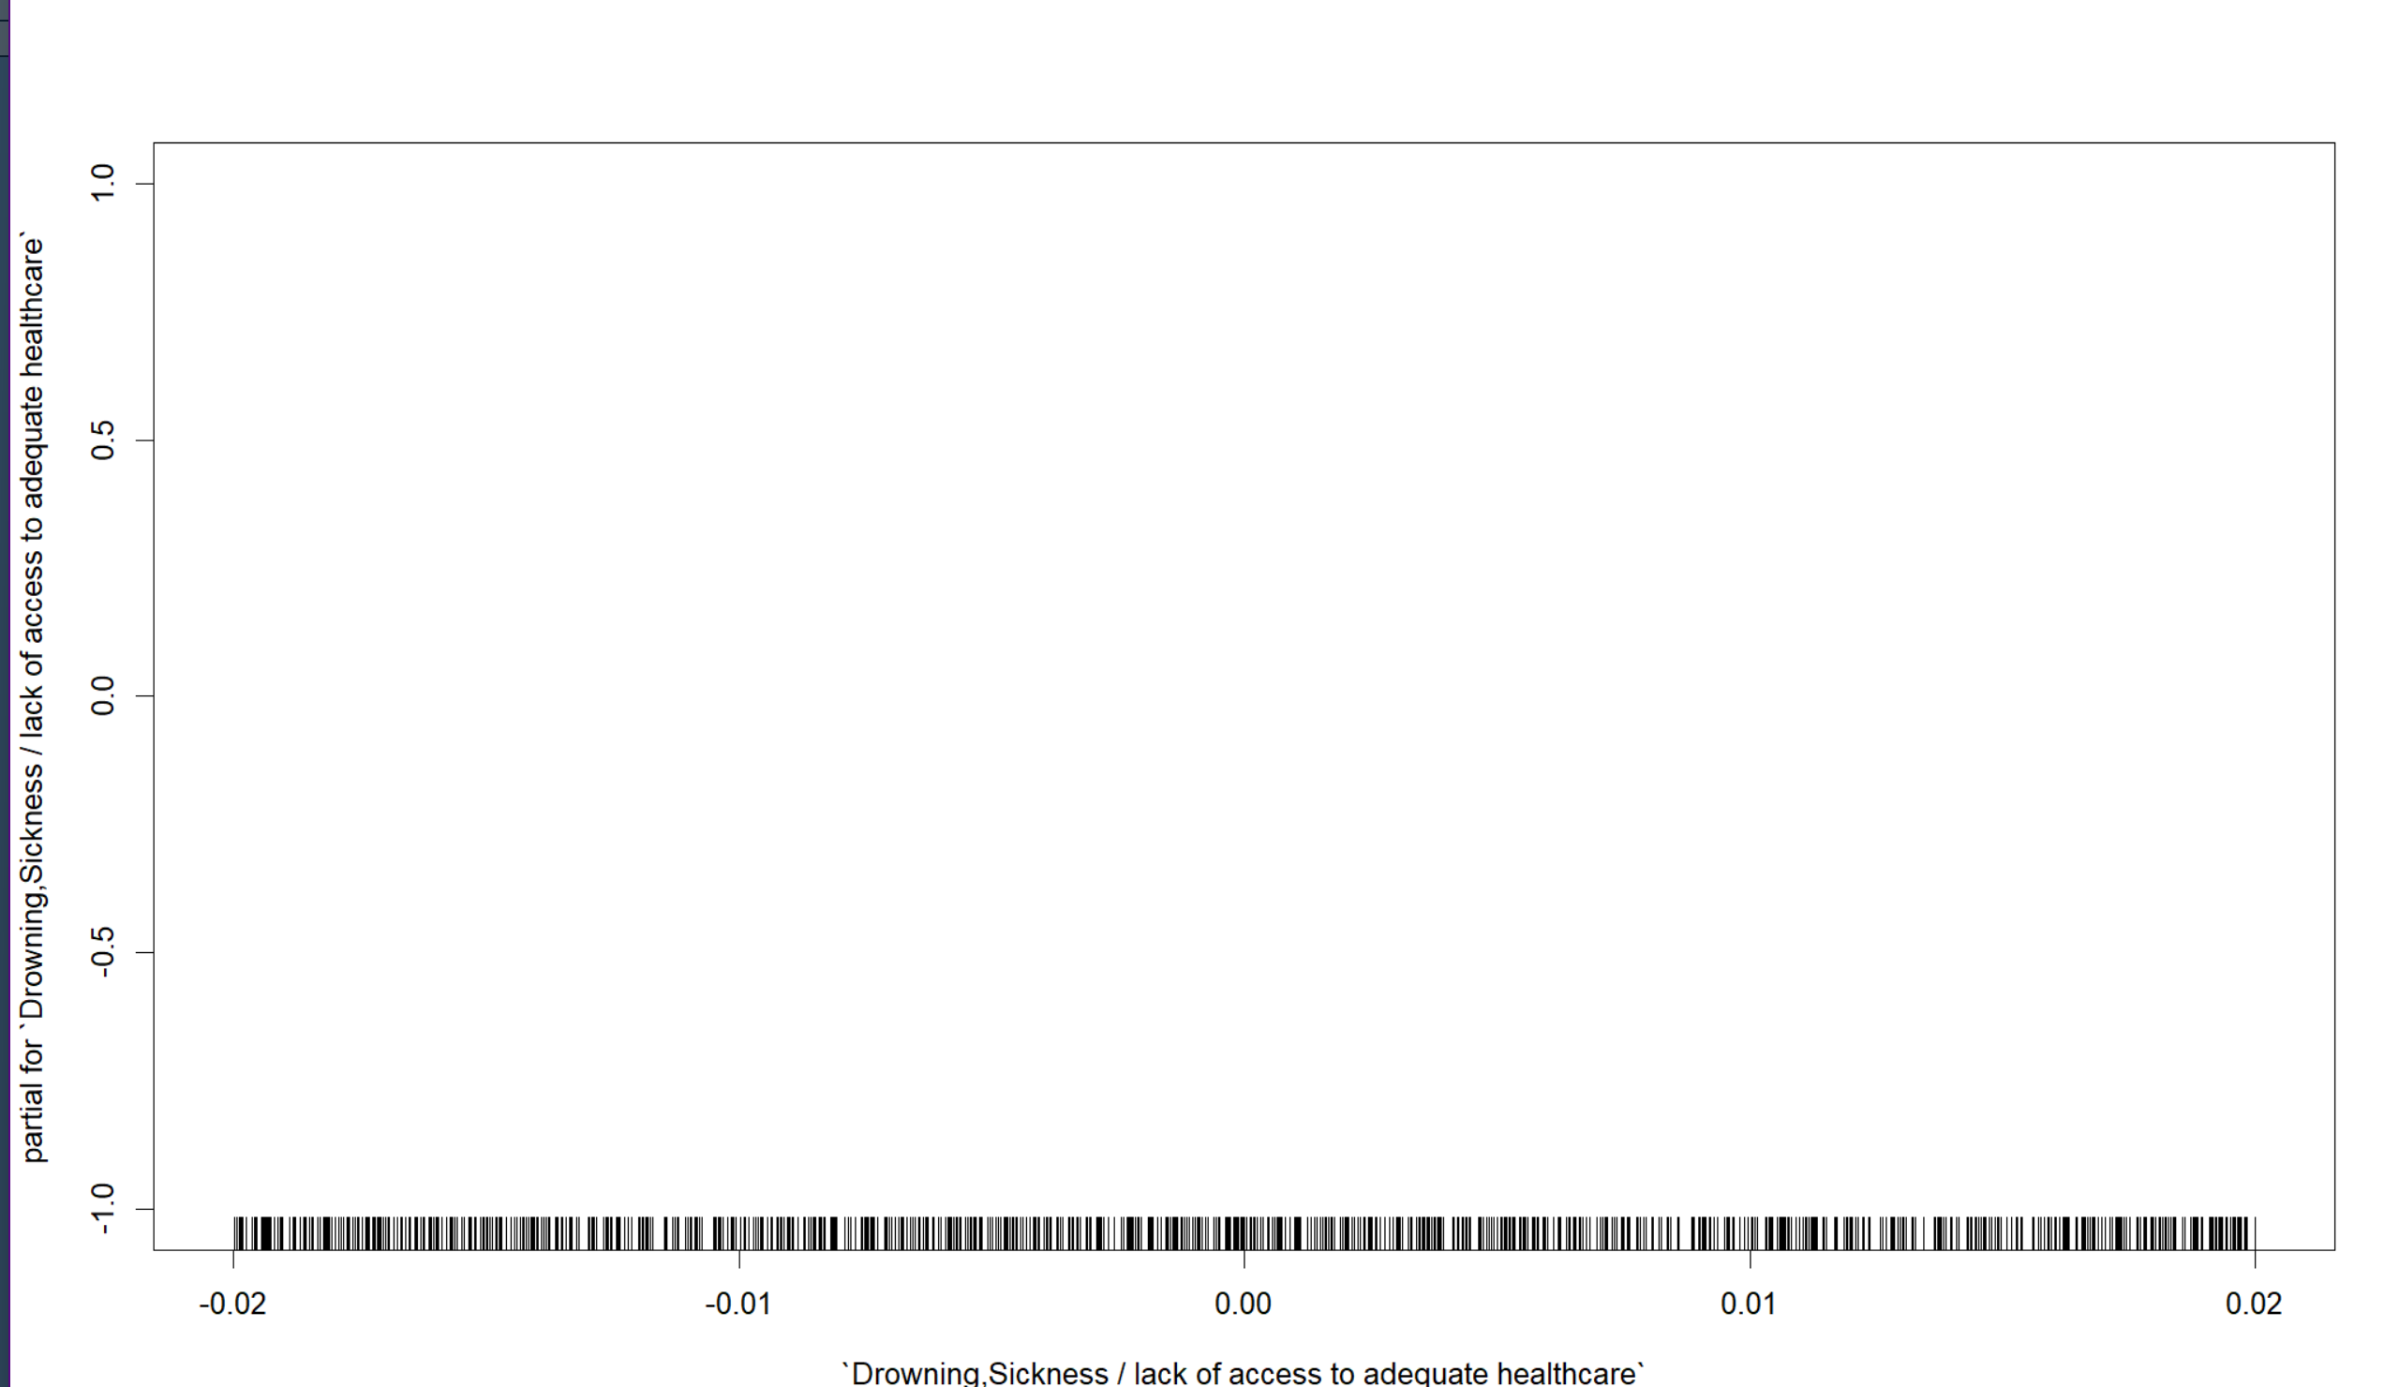
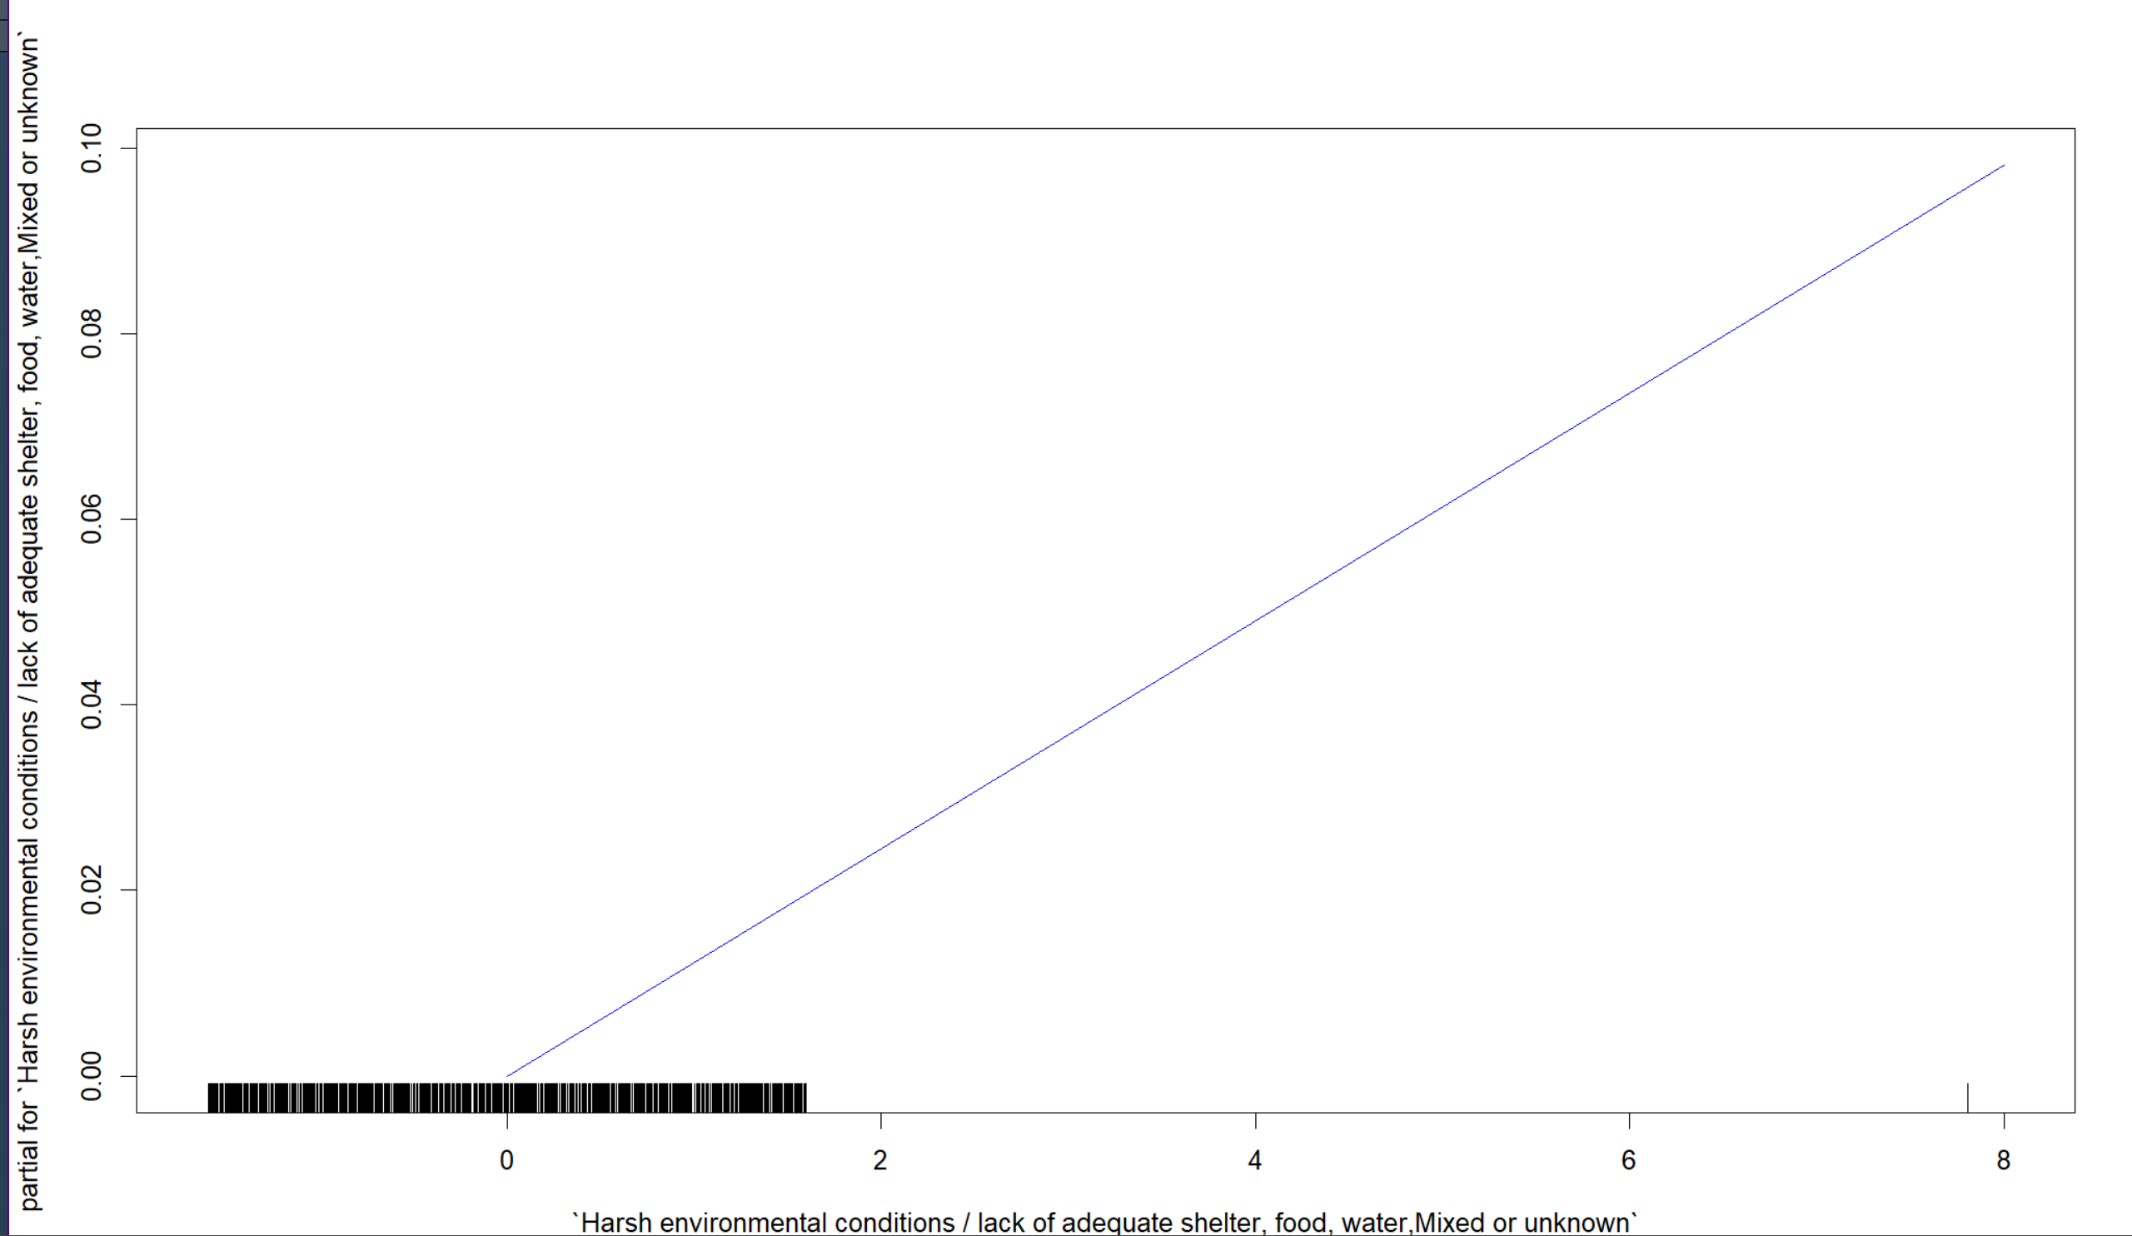
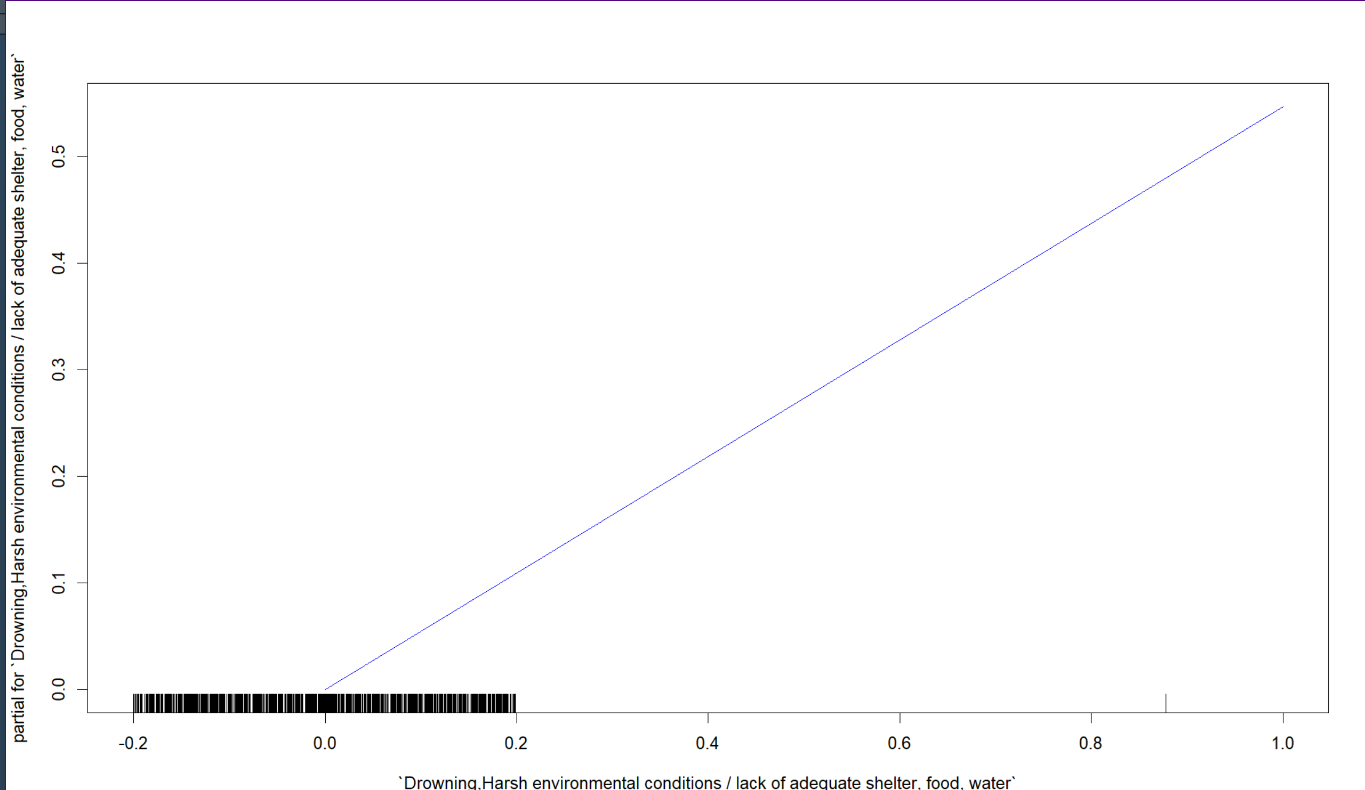
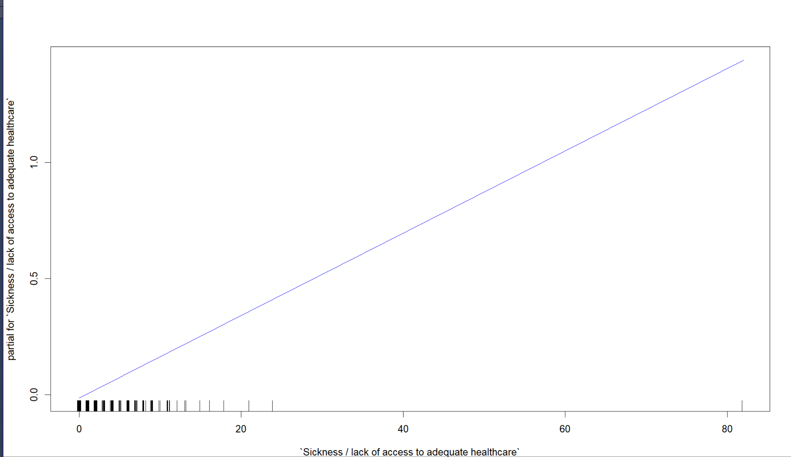
Gam Plot-1(a)

Slide 19
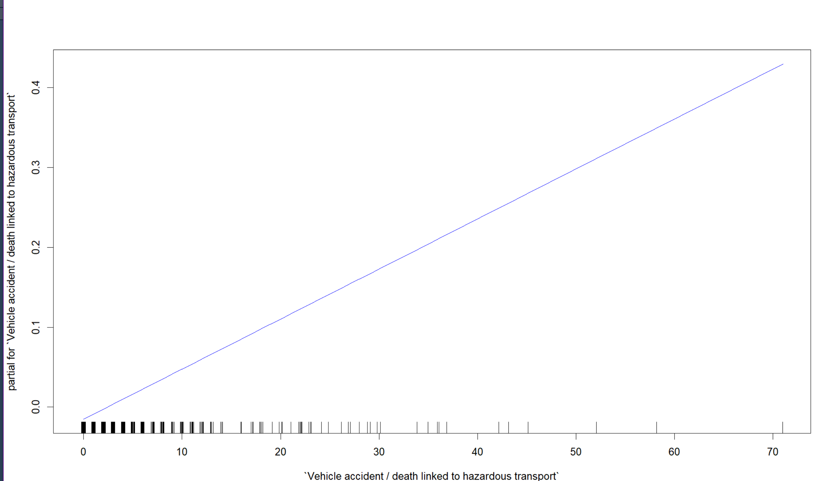
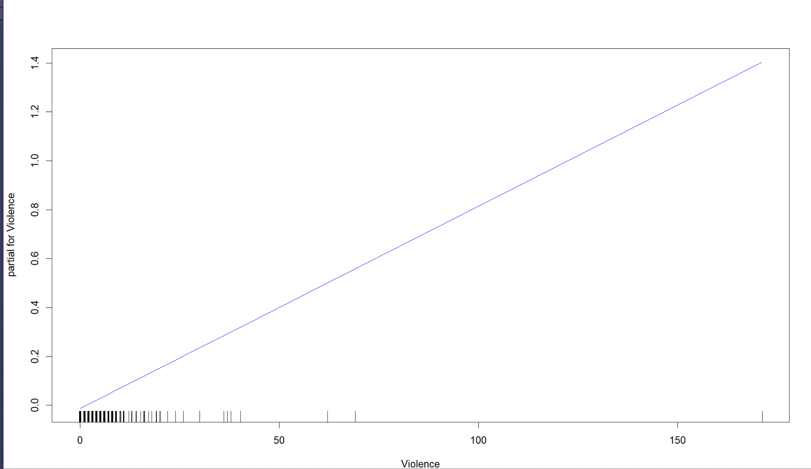
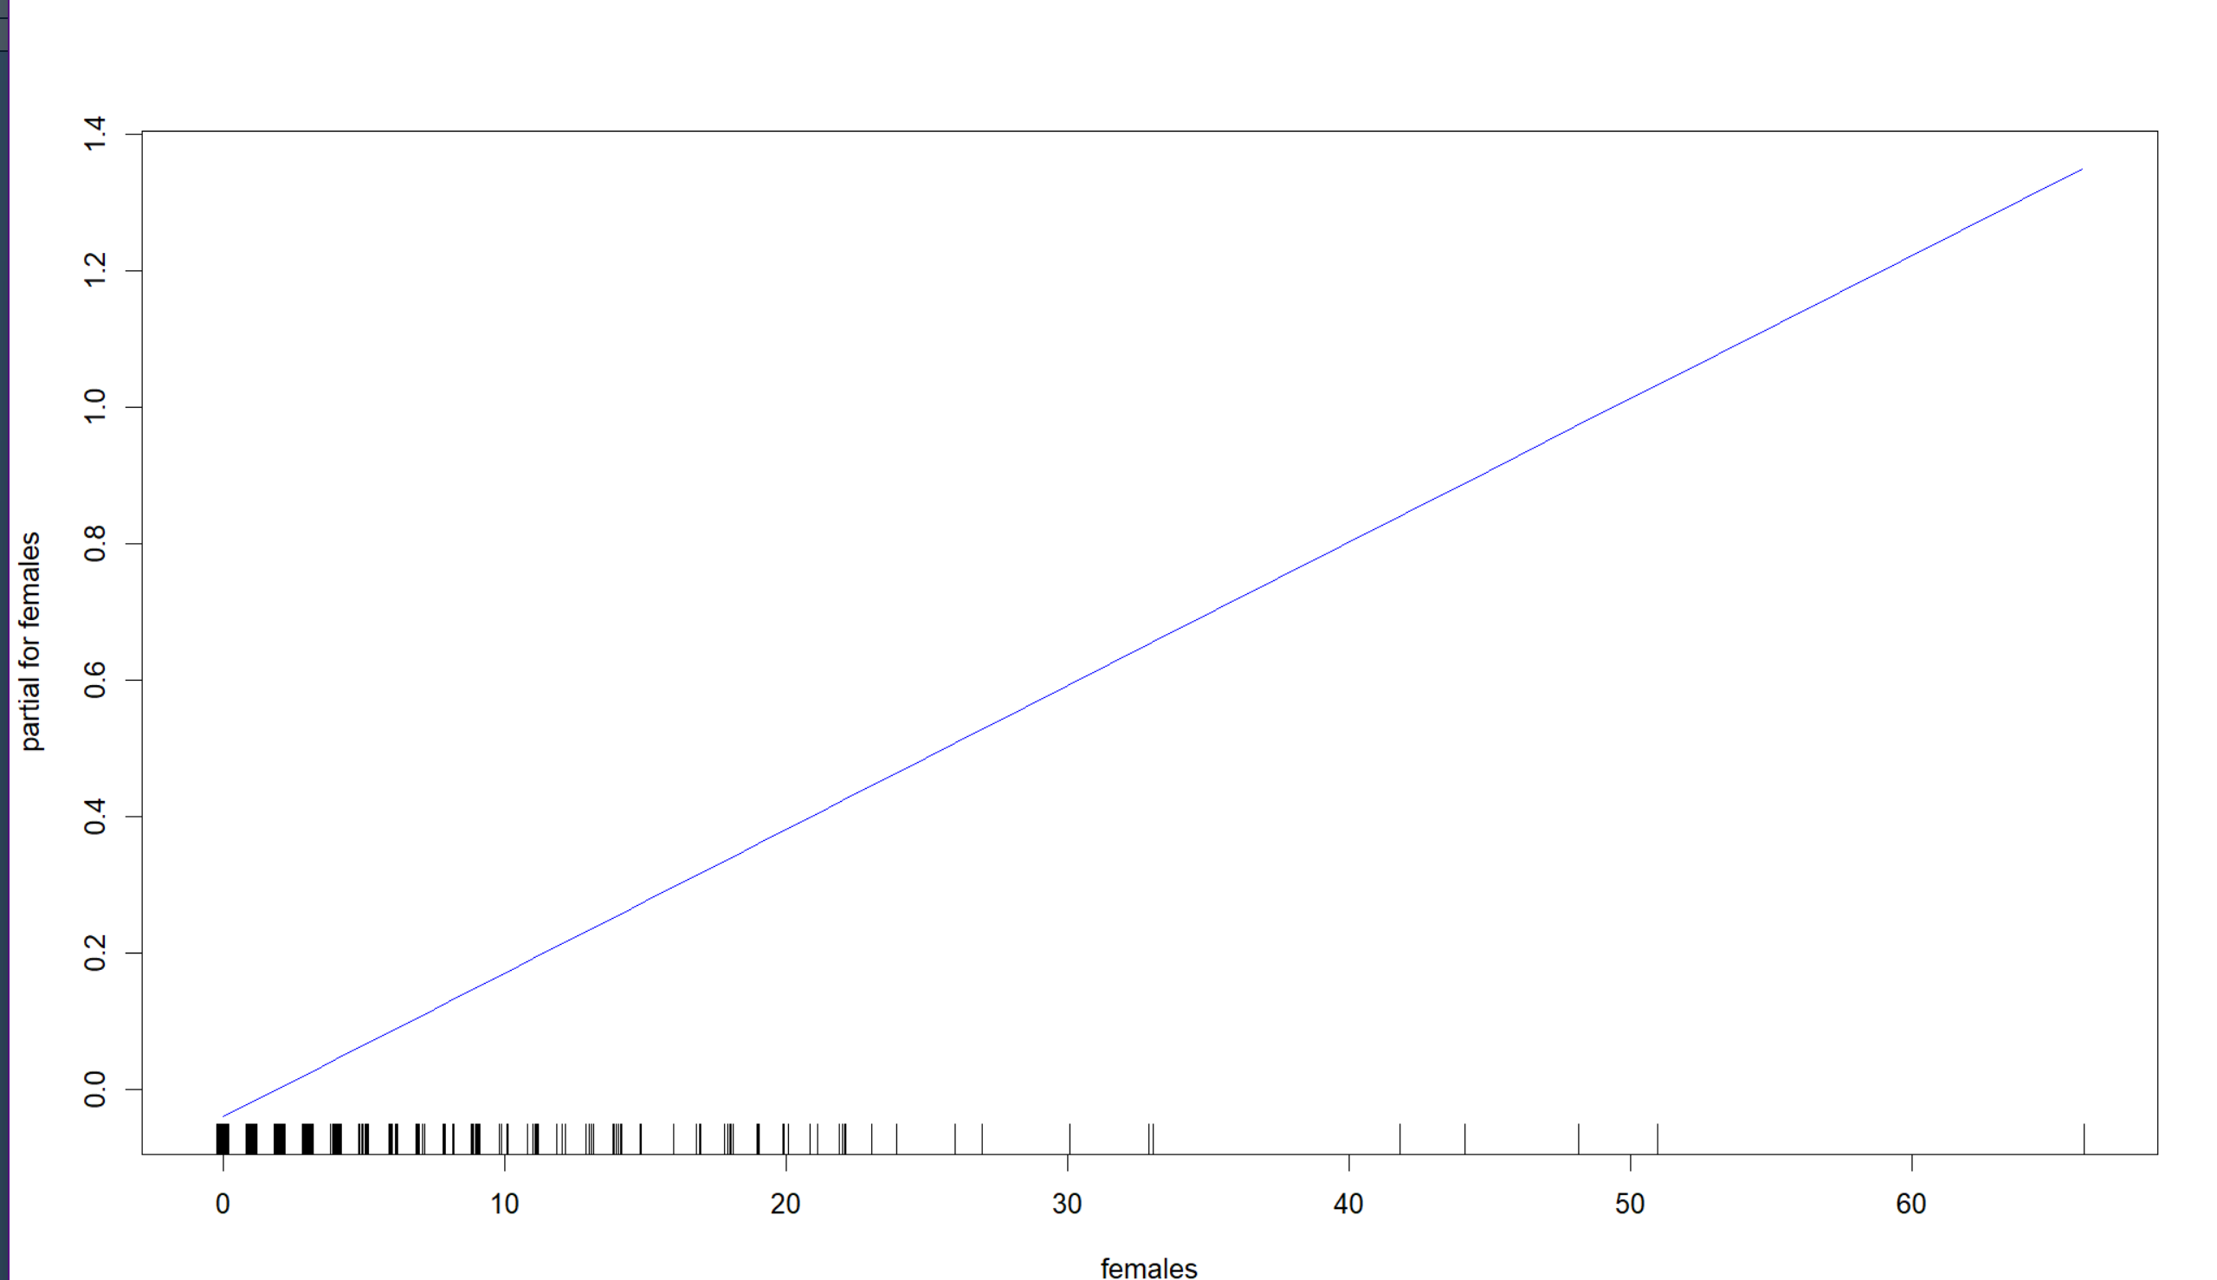
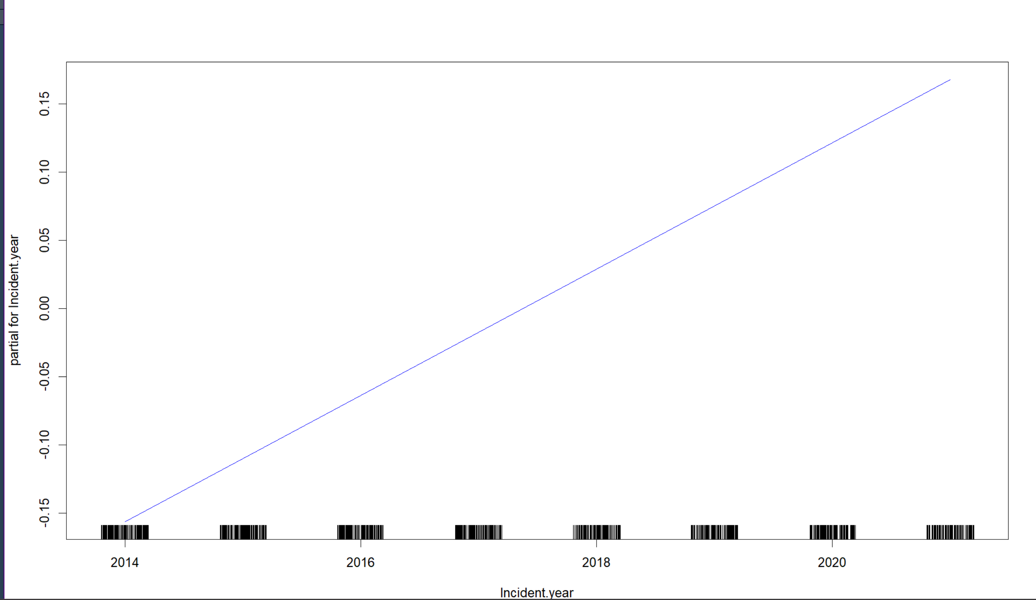
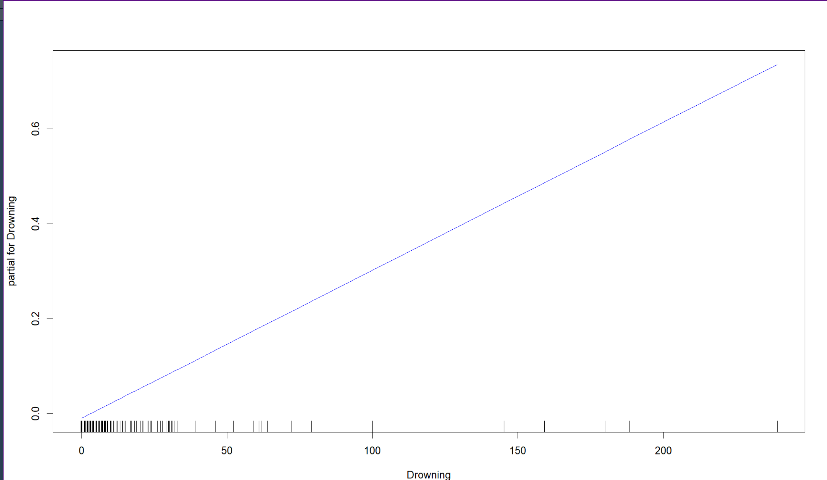
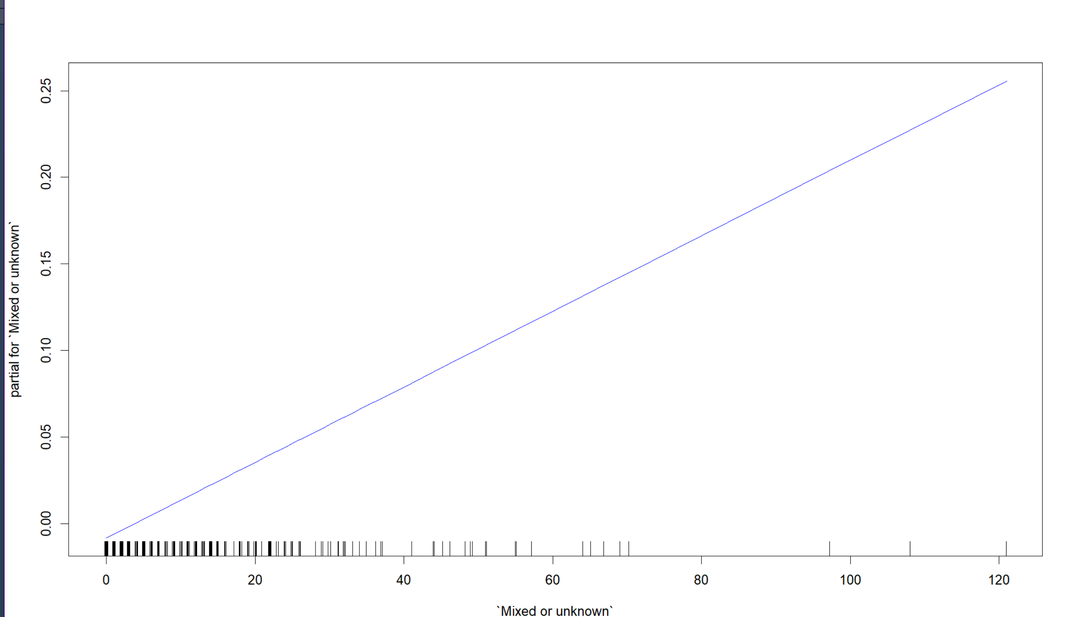
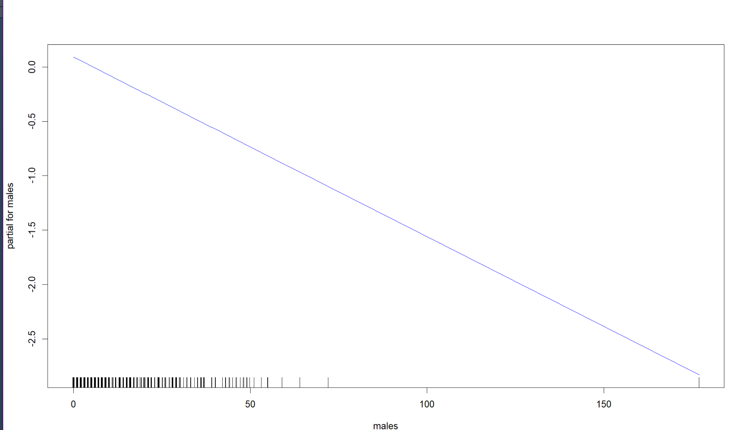
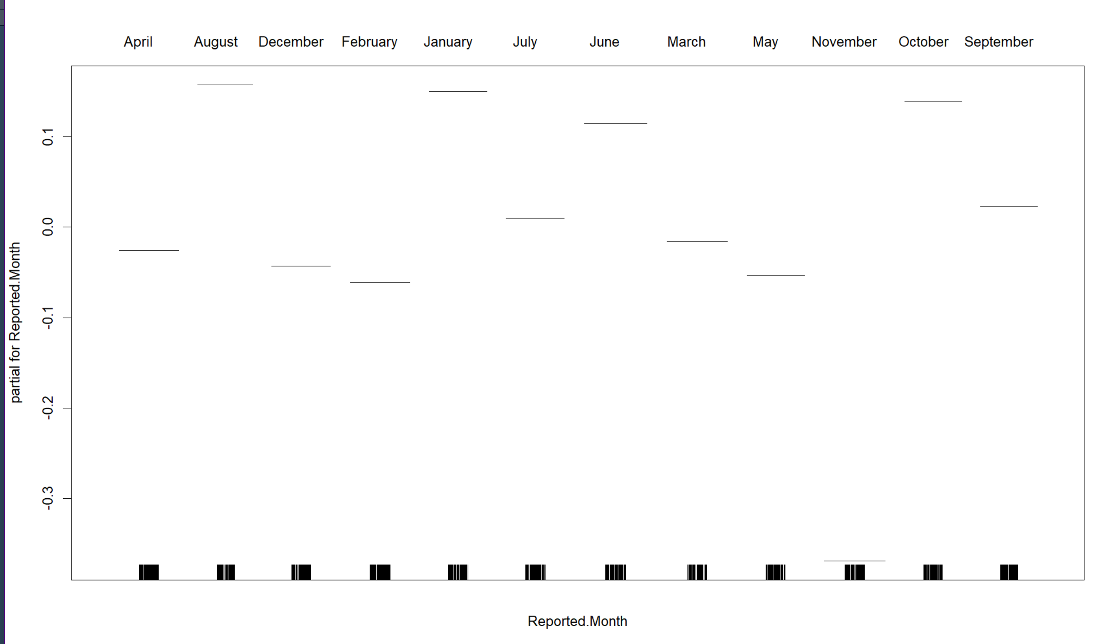
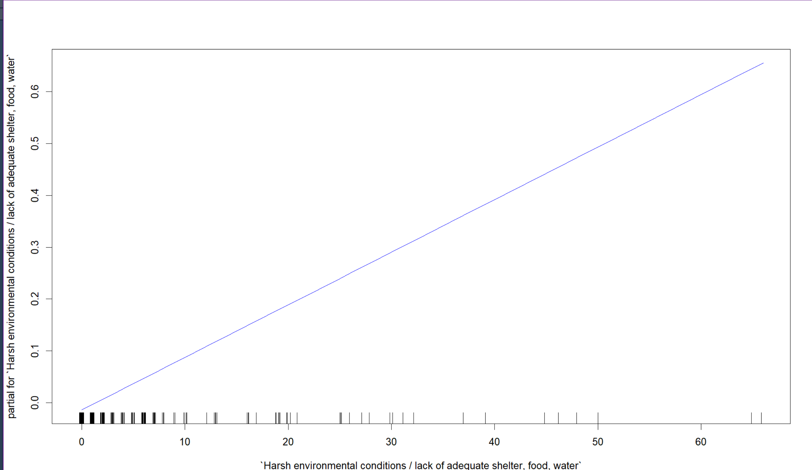
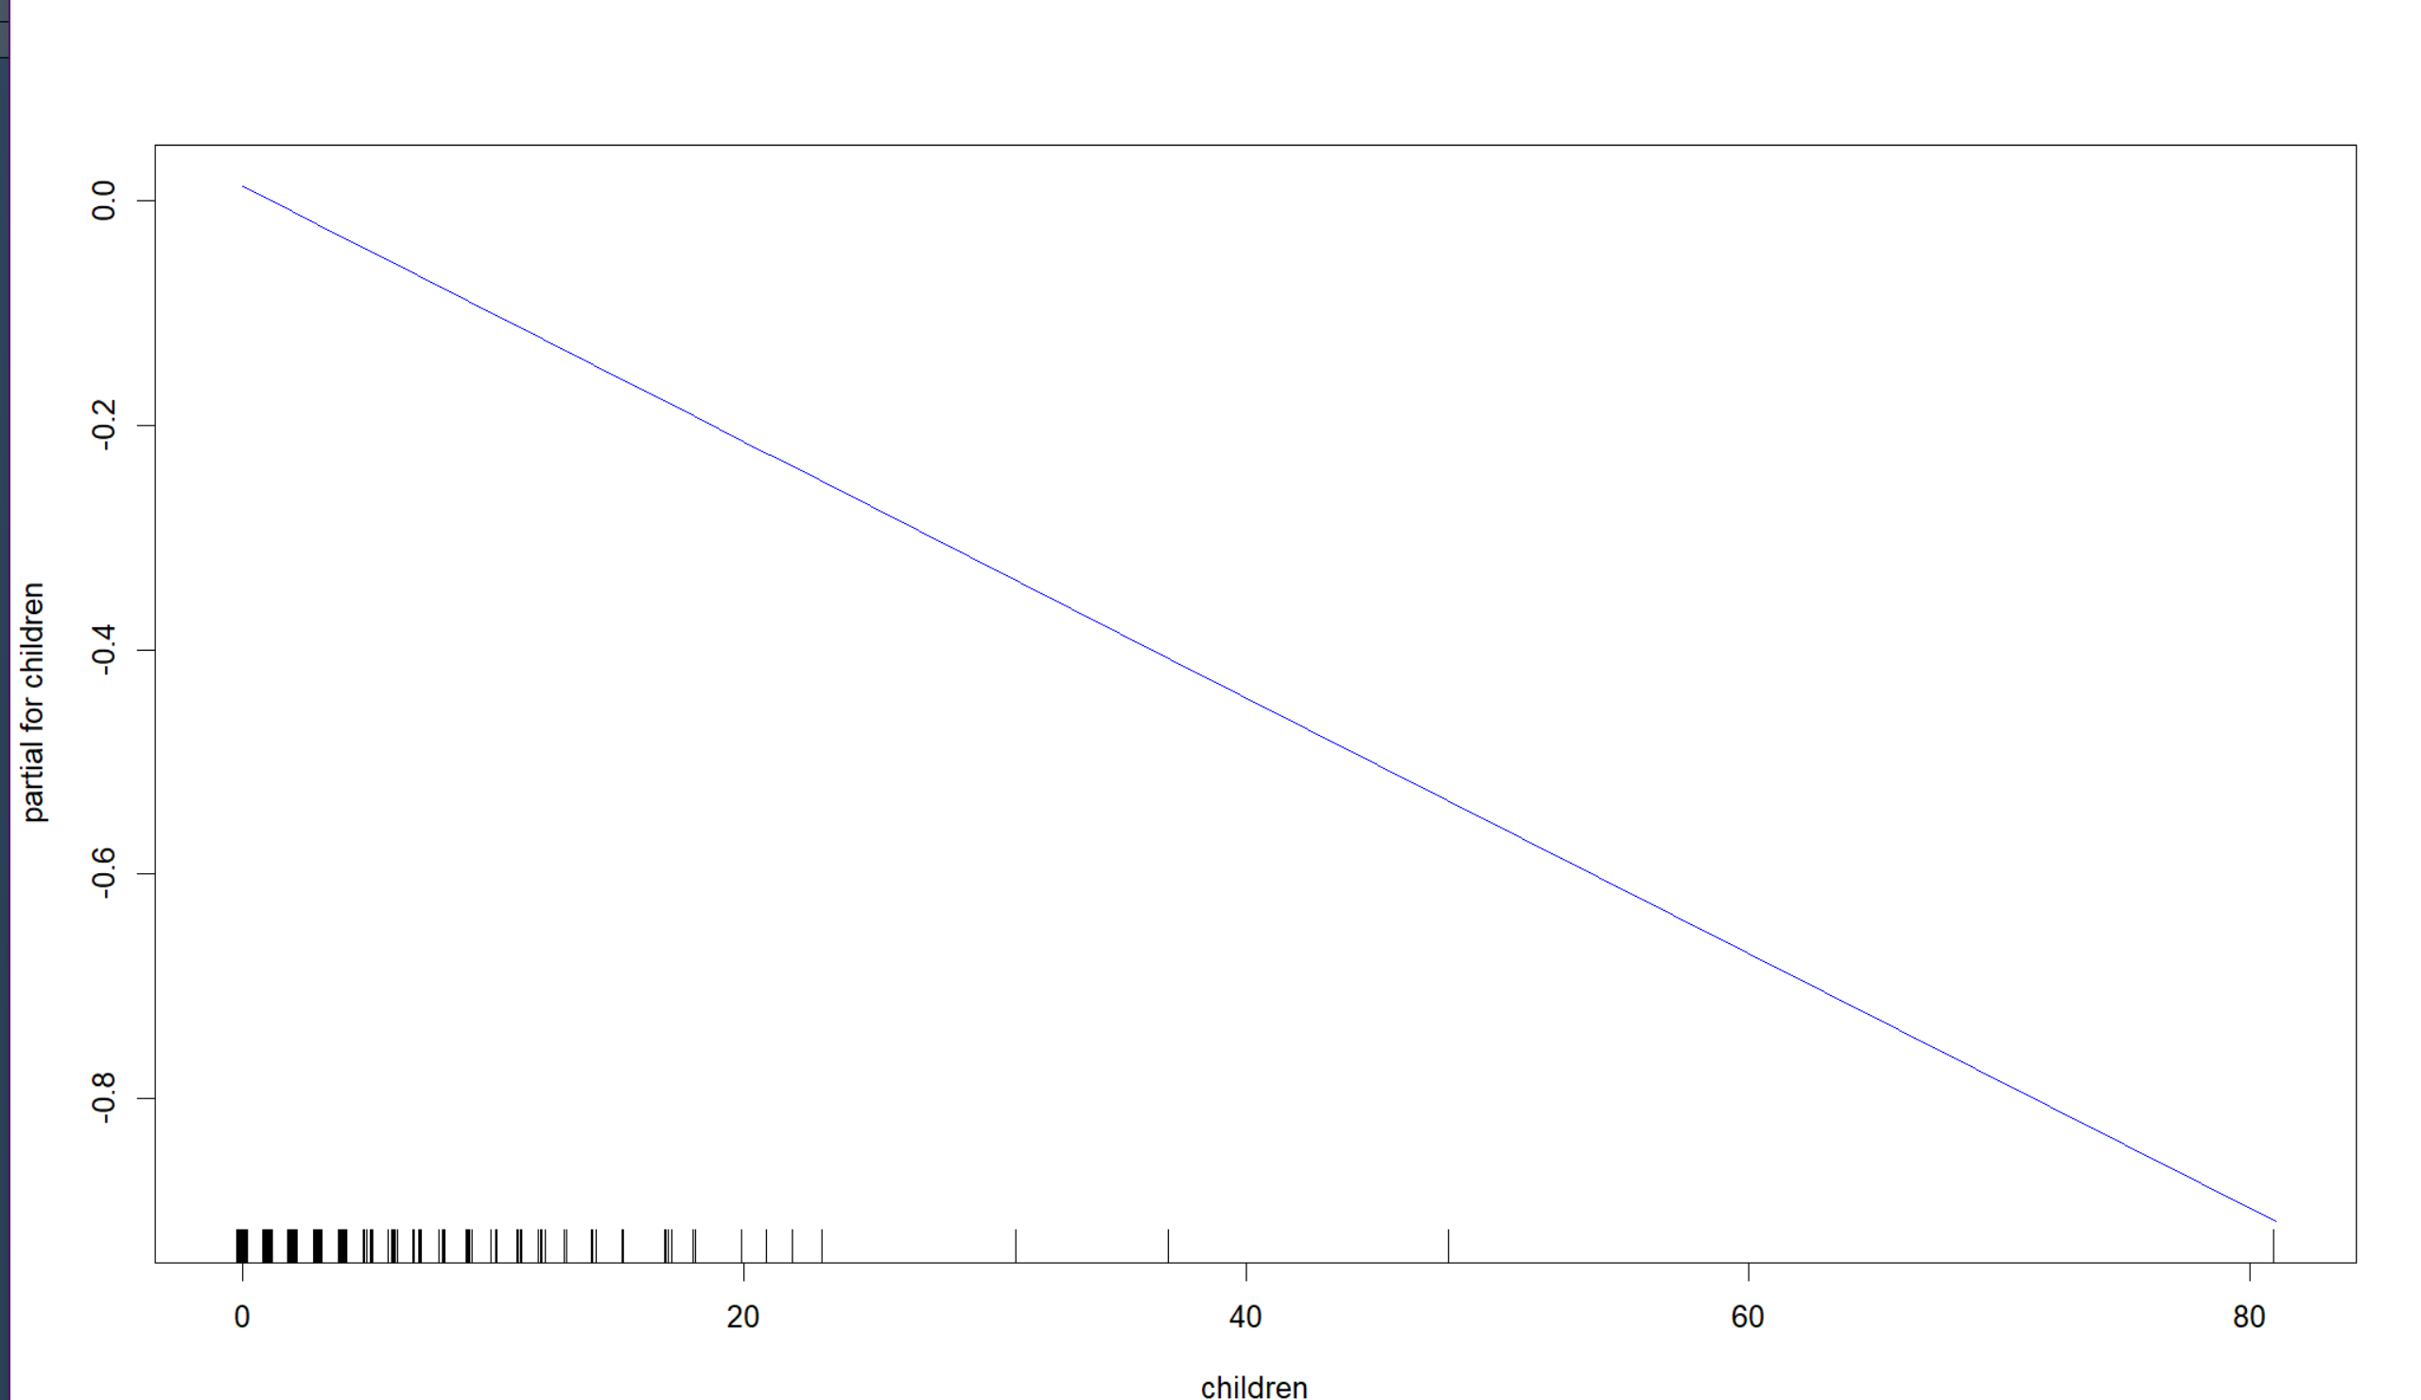
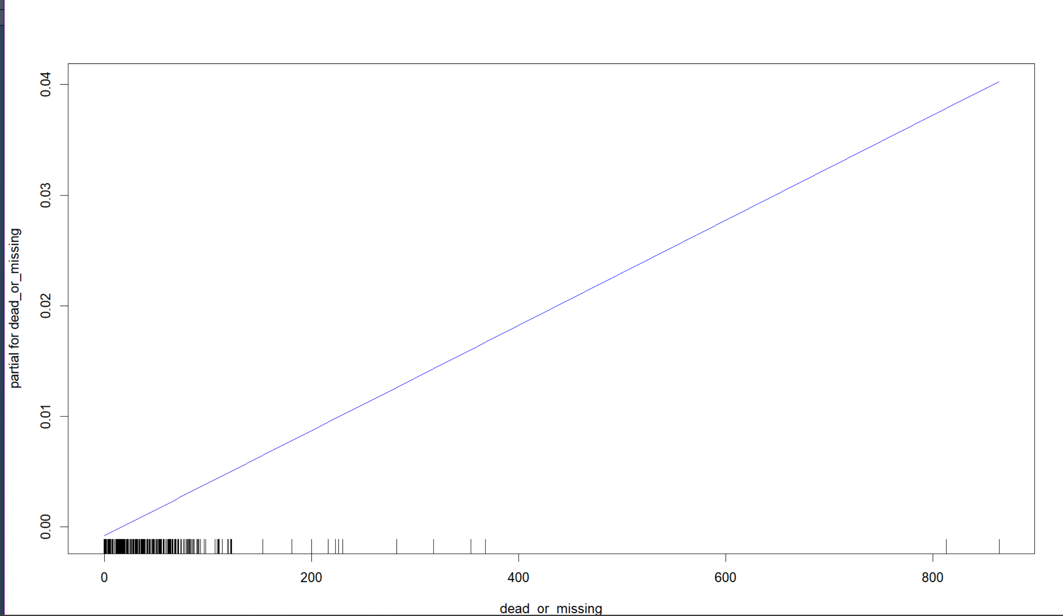
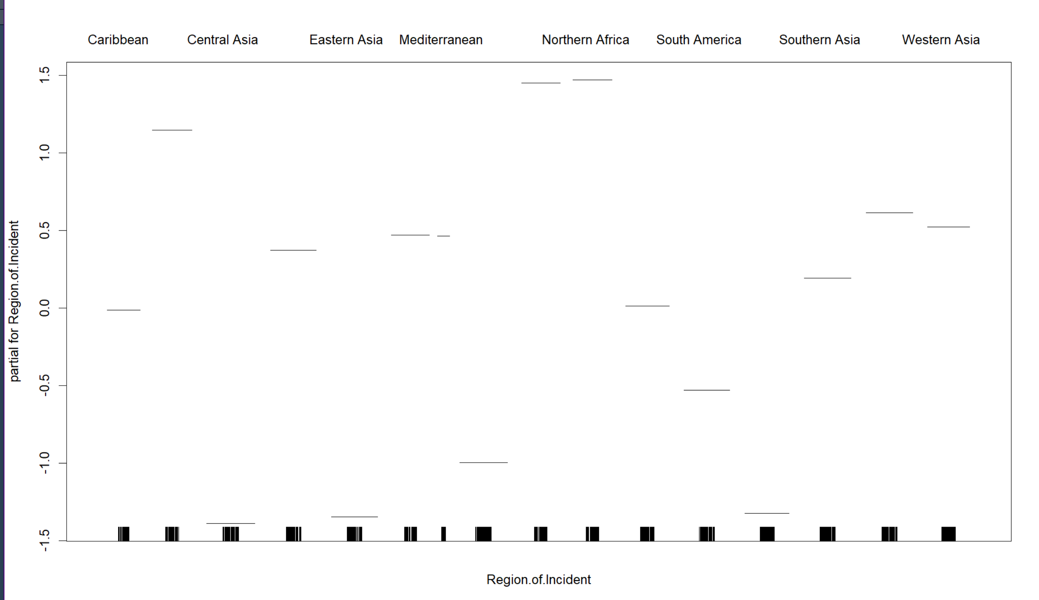
Gam Plot-1(b)

Slide 20
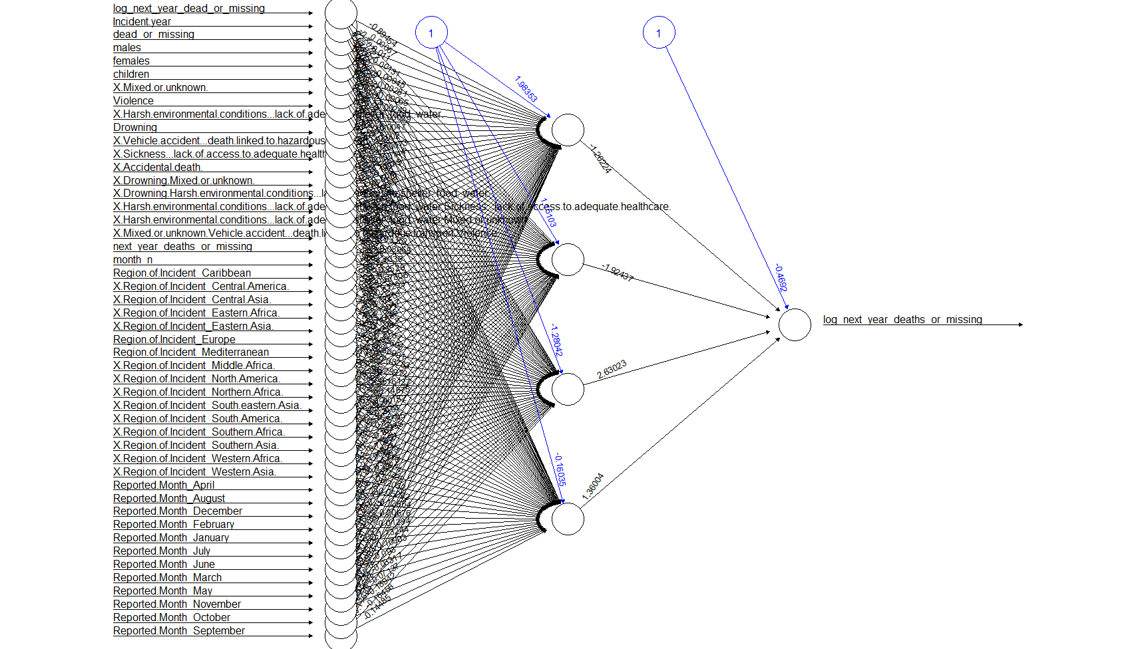
NN Plot

Slide 21
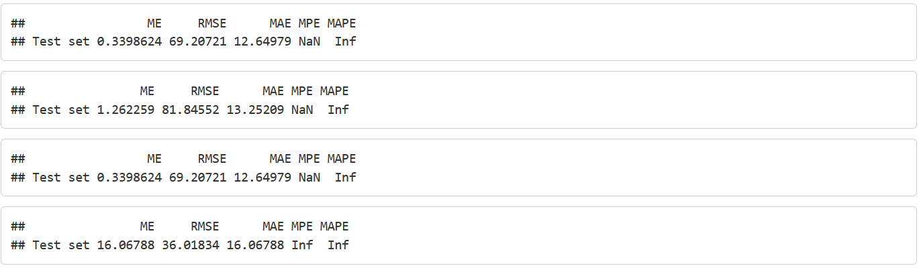
lm_full
lm_bwd
gam
nn

Slide 22
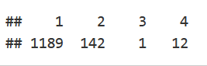
K-mean Clustering
We will look at the missing migrants’ data and then try to club similar observations and form different groups of clusters.
Prediction: log_next_year_dead_or_missing
We will start by fitting four clusters to the missing migrants’ data. To run K-means on our data we use the kmeans() function. The parameters we need to set for the K-means algorithm are:
x - The data we want the algorithm to cluster.
centers - The number of clusters to generate.
itermax - The number of iterations to let k-means perform.
nstart - The number of starts to try for K-means.

Slide 23
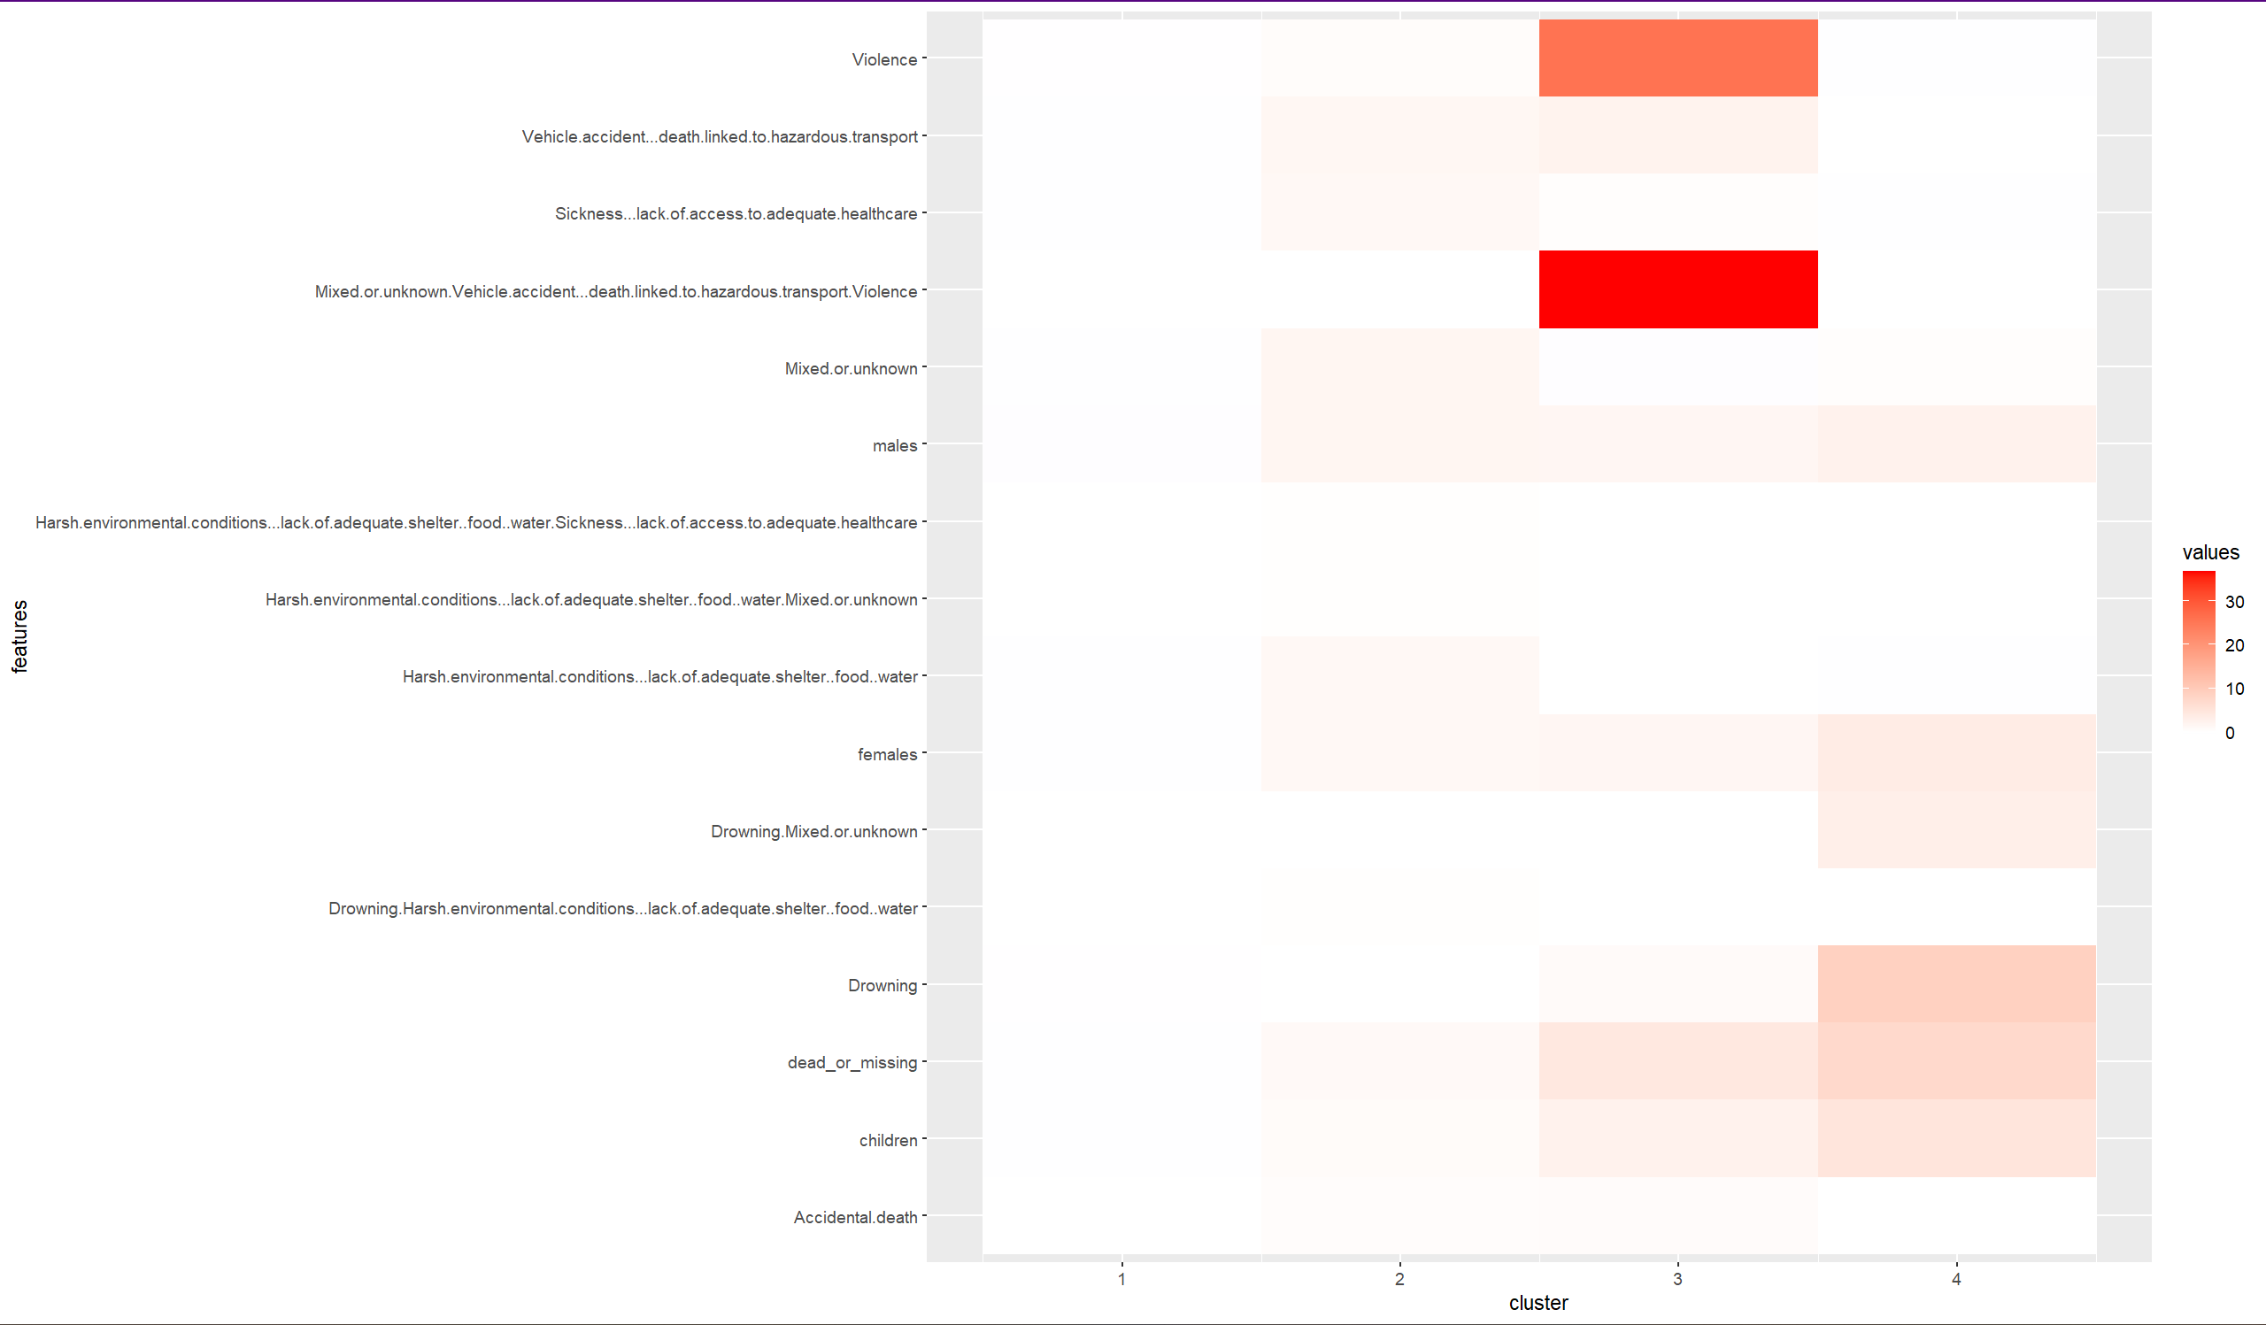
Heat Map with k=4

Slide 24
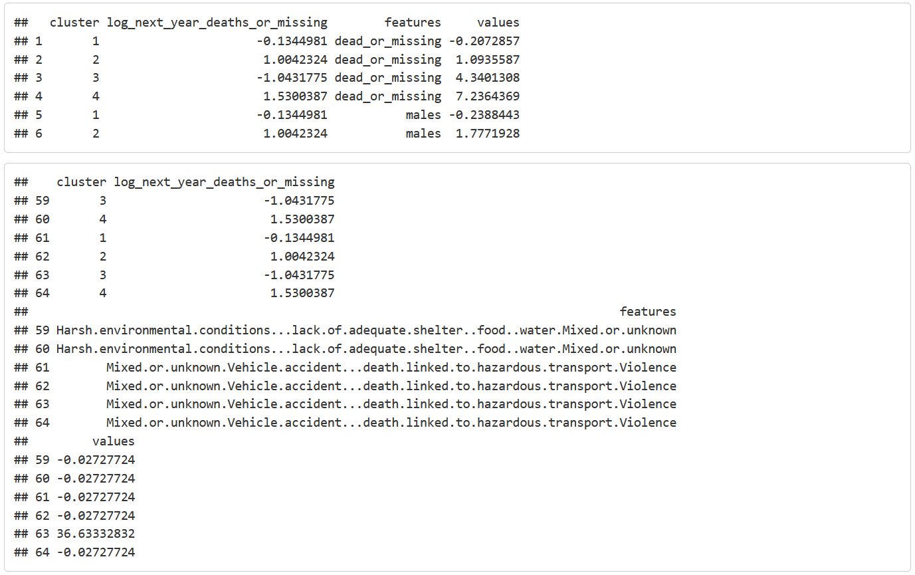
Comparison of center values for each of the clusters (k=4) to each other.

Slide 25
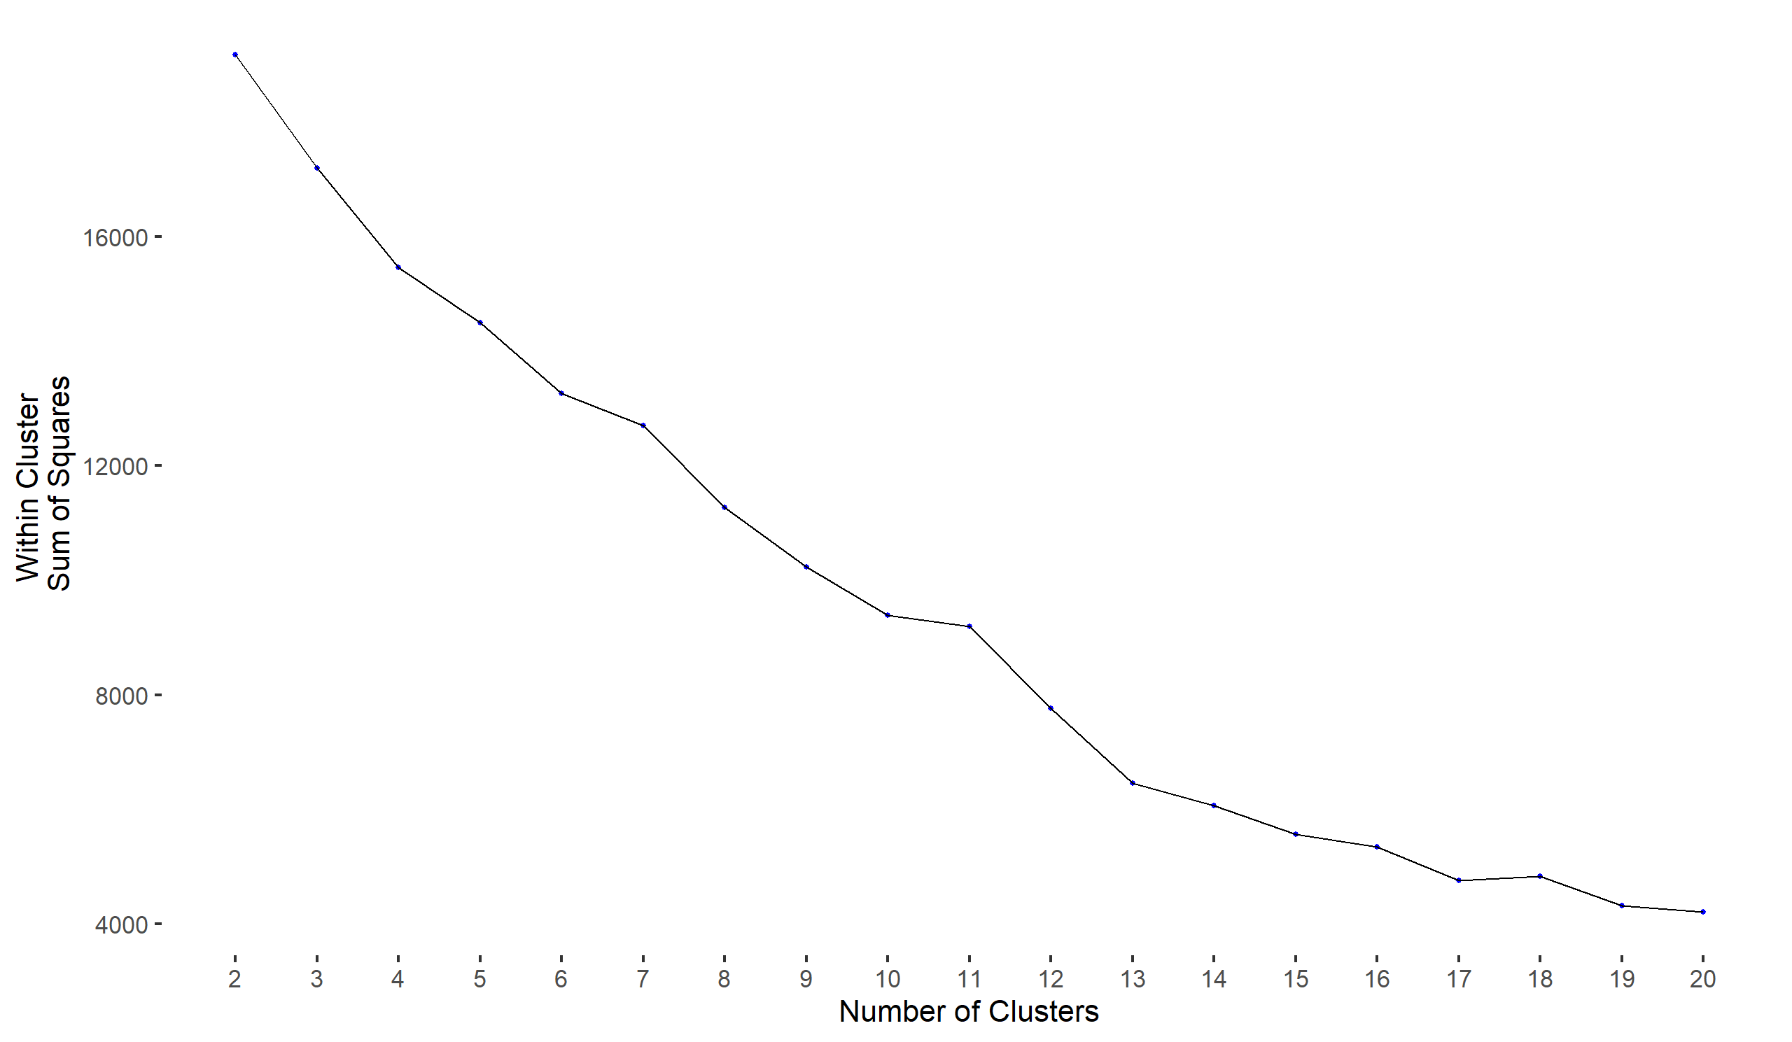
Within Cluster Sum of Squares

Slide 26


First Round of Clustering vs Second: Clustering Cardinality

Slide 27


Cluster sum of squares for each cluster: Cluster Magnitude

Slide 28


Magnitude v Cardinality

Slide 29

Higher Silhouette Score is better
Average Silhouette Width

Slide 30

The Gap Statistic

Slide 31

Heat Map with k=2

Slide 32

Comparison of center values for each of the clusters (k=2) to each other.
Not optimal!

Slide 33

Heat Map with k=6

Slide 34

Comparison of center values for each of the clusters (k=6) to each other.
Optimal!

Slide 35
Findings
Highest predictors for future Incidents of death and missing cases:
Region of Migrants’ Origin (Stats, Viz)
Sub-Saharan Africa
Region of Incident + Route (Linear Regression, Viz)
Northern Africa(overall)
Central Mediterranean (frequency)
Death and missing case by Gender (Stats, Viz)
Women and Children
Known cause of Deaths-subcategories (K-mean Clustering)
Vehicle accident, Death linked to hazardous transport, Violence, Drowning

Slide 36
Recommendations
Refugee friendly policies
Targeted resources (funding, security)
Increase research and publications
Human first approach in decision making
Mindset change (John Rawl’s Veil of Ignorance*)
*Philosopher John Rawls suggests that we should imagine we sit behind a veil of ignorance that keeps us from knowing who we are and identifying with our personal circumstances. By being ignorant of our circumstances, we can more objectively consider how society should operate.

Slide 37
A Single Death Is a Tragedy; A Million Deaths Is a Statistic
The End

